Slide 1



Denuwan(WHDR) creation

Slide 2

CIE 12 STUDENT PPT
EVOLUTION
Press enter
Denuwan(WHDR) creation

Slide 3

EVOLUTION MODE
EXTRAS MODE
EXIT
Denuwan(WHDR) creation

Slide 4
EVOLUTION MODE
EXTRAS MODE
EXIT
Denuwan(WHDR) creation

Slide 5
EVOLUTION MODE
EXTRAS MODE
EXIT
Denuwan(WHDR) creation

Slide 6
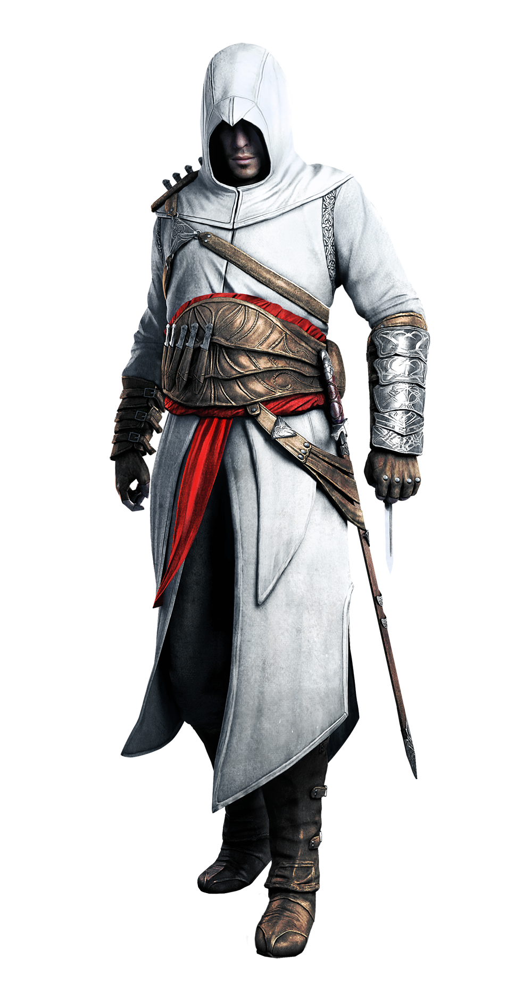
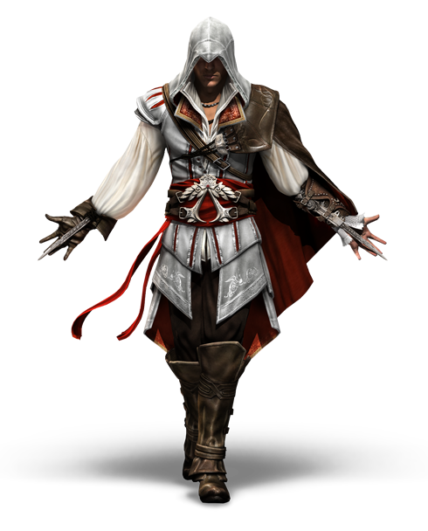
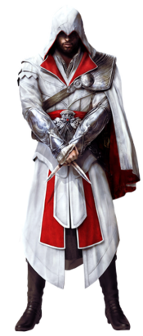
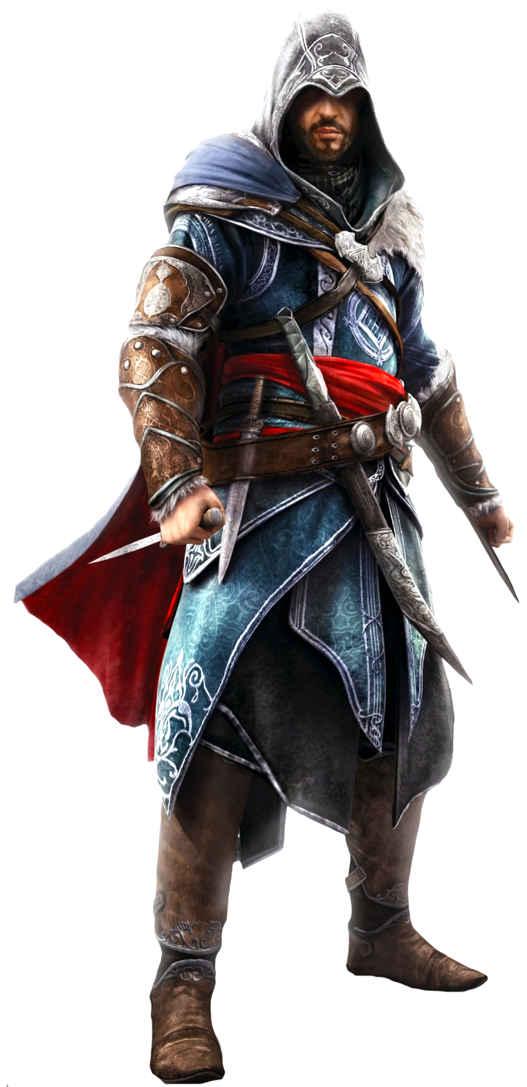
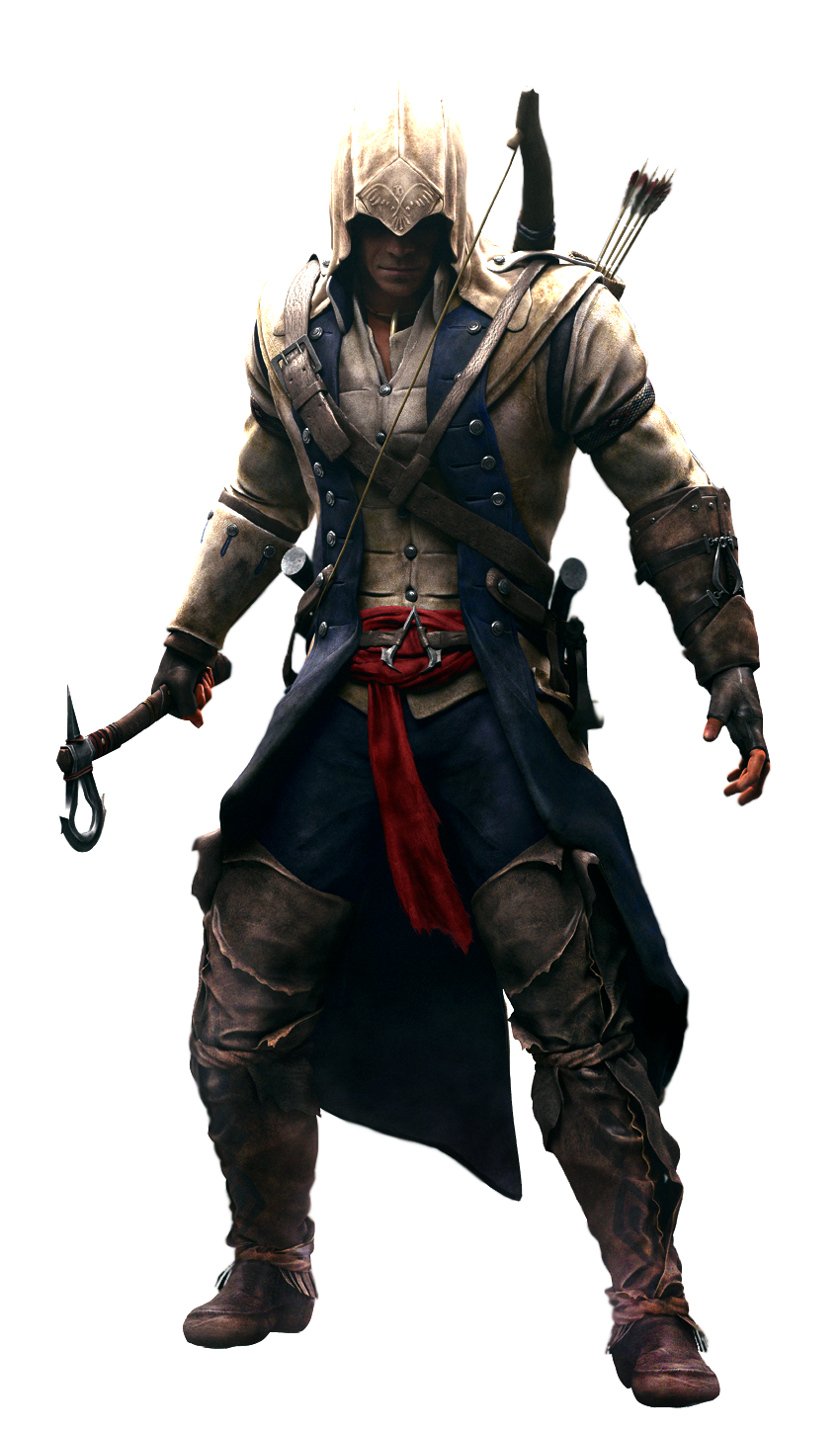
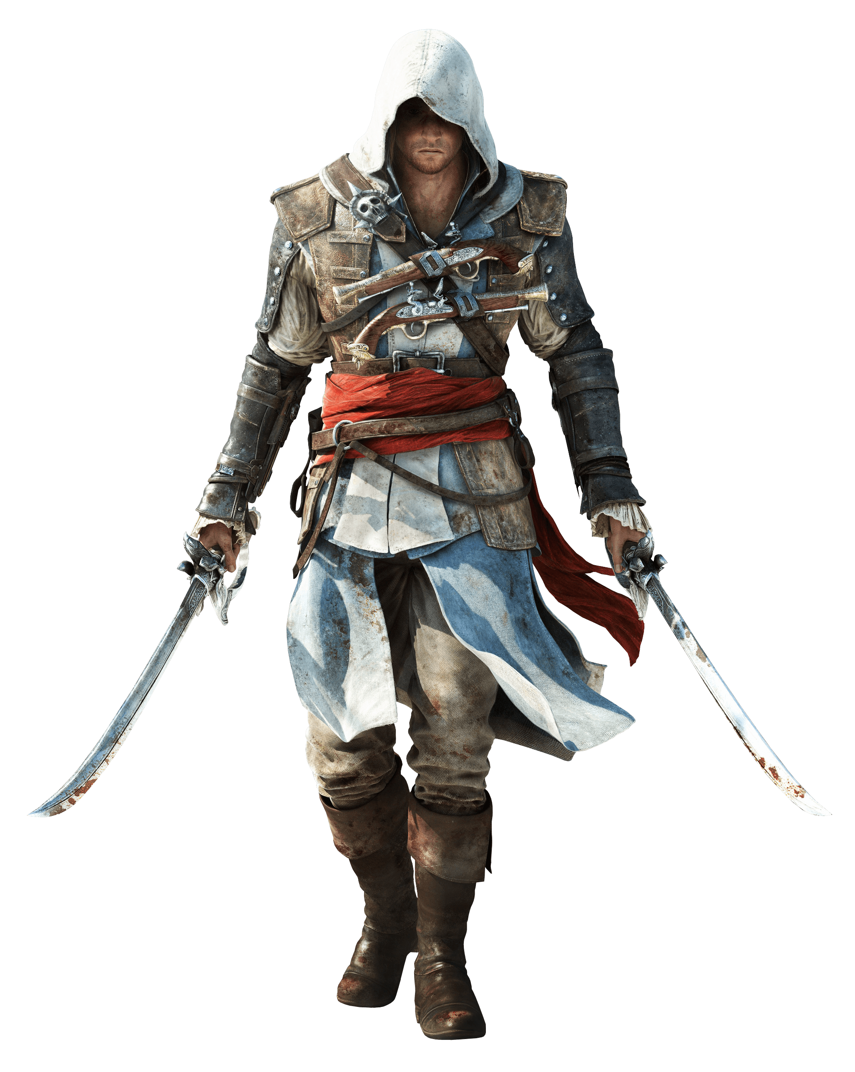

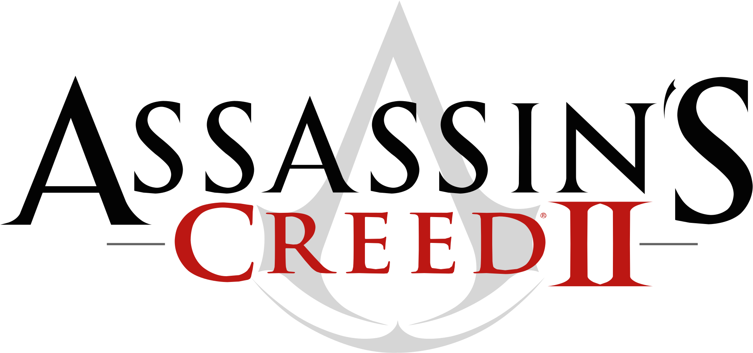
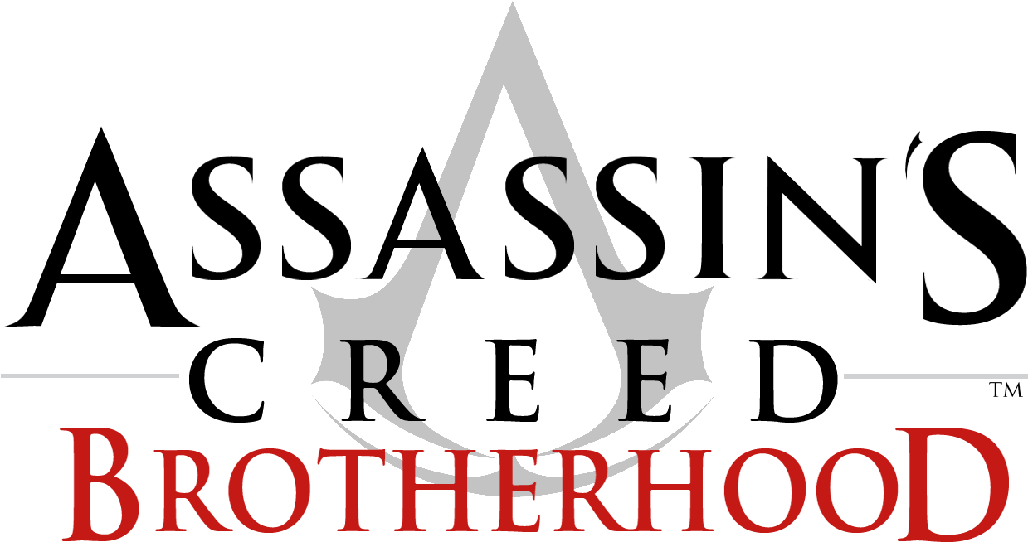

EVOLUTION
HOME
Denuwan(WHDR) creation

Slide 7
EVOLUTION
HOME
Denuwan(WHDR) creation

Slide 8
EVOLUTION
HOME
Denuwan(WHDR) creation

Slide 9
EVOLUTION
HOME
Denuwan(WHDR) creation

Slide 10
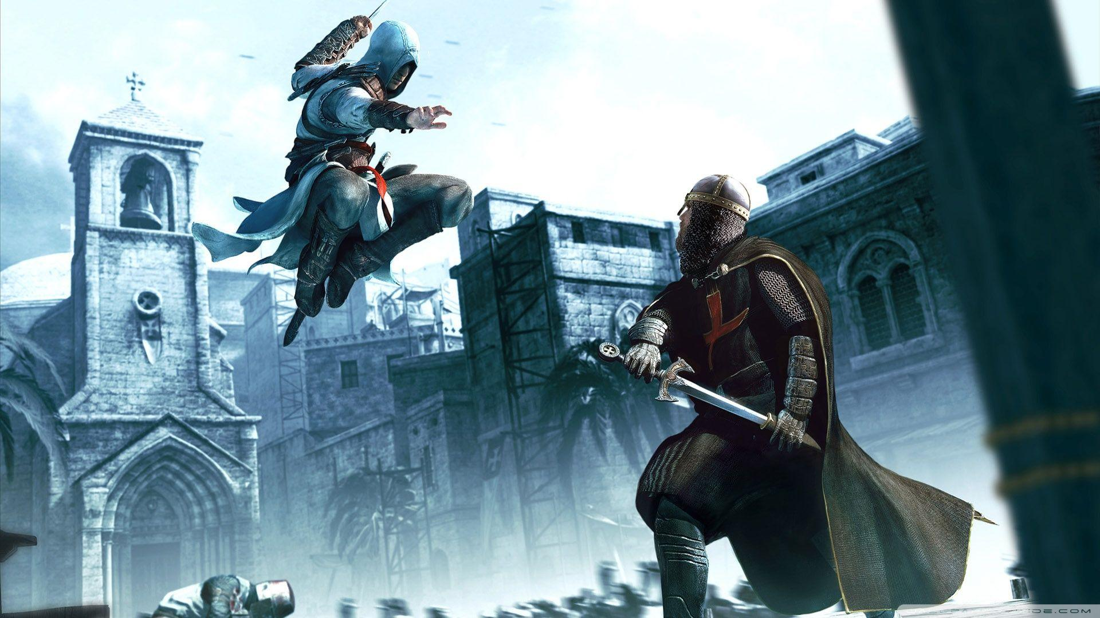





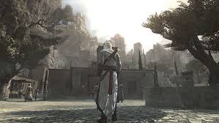
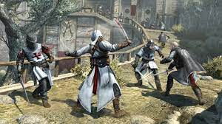
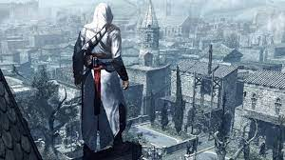
EVOLUTION
HOME
Assassin's Creed is an action-adventure game developed by Ubisoft Montreal and published by Ubisoft. It is the first install in the Assassin's Creed series. The video game was released for PlayStation 3 and Xbox 360 in November 2007. A Microsoft Windows version titled Assassin's Creed: Director's Cut Edition containing additional content was released in April 2008.
PC System requirements
Minimum
OS: Windows :Vista/XP/7/8/10
Processor: Dual core 2.6GHZ/1.8 GHz Intel Core2 Duo or 2.4 GHz AMD
Video: 256 MB DirectX 9.0.
RAM: 1.5/2 GB.
Storage: 8 GB.
Sound Card: DirectX 9.0c–compliant sound card.
Denuwan(WHDR) creation
The plot is set in a fictional history of real-world events, taking place primarily during the Third Crusade in the Holy Land in 1191. The player character is a modern-day man named Desmond Miles who, through a machine called the Animus, relives the genetic memories of his ancestor, Altaïr Ibn-La'Ahad. Through this plot device, details emerge about a millennia-old struggle between two factions: the Assassin Brotherhood (inspired by the real-life Order of Assassins), who fight to preserve peace and free will, and the Templar Order (inspired by the Knights Templar military order), who seek to establish peace through order and control. Both factions fight over powerful artifacts of mysterious origins known as Pieces of Eden to gain an advantage over each other. The 12th-century portion of the story follows Altaïr, an Assassin, who embarks on a quest to regain his honour after botching a mission to recover one such artifact from the Templars; he does so by finding and assassinating nine targets across the Holy Land.

Slide 11
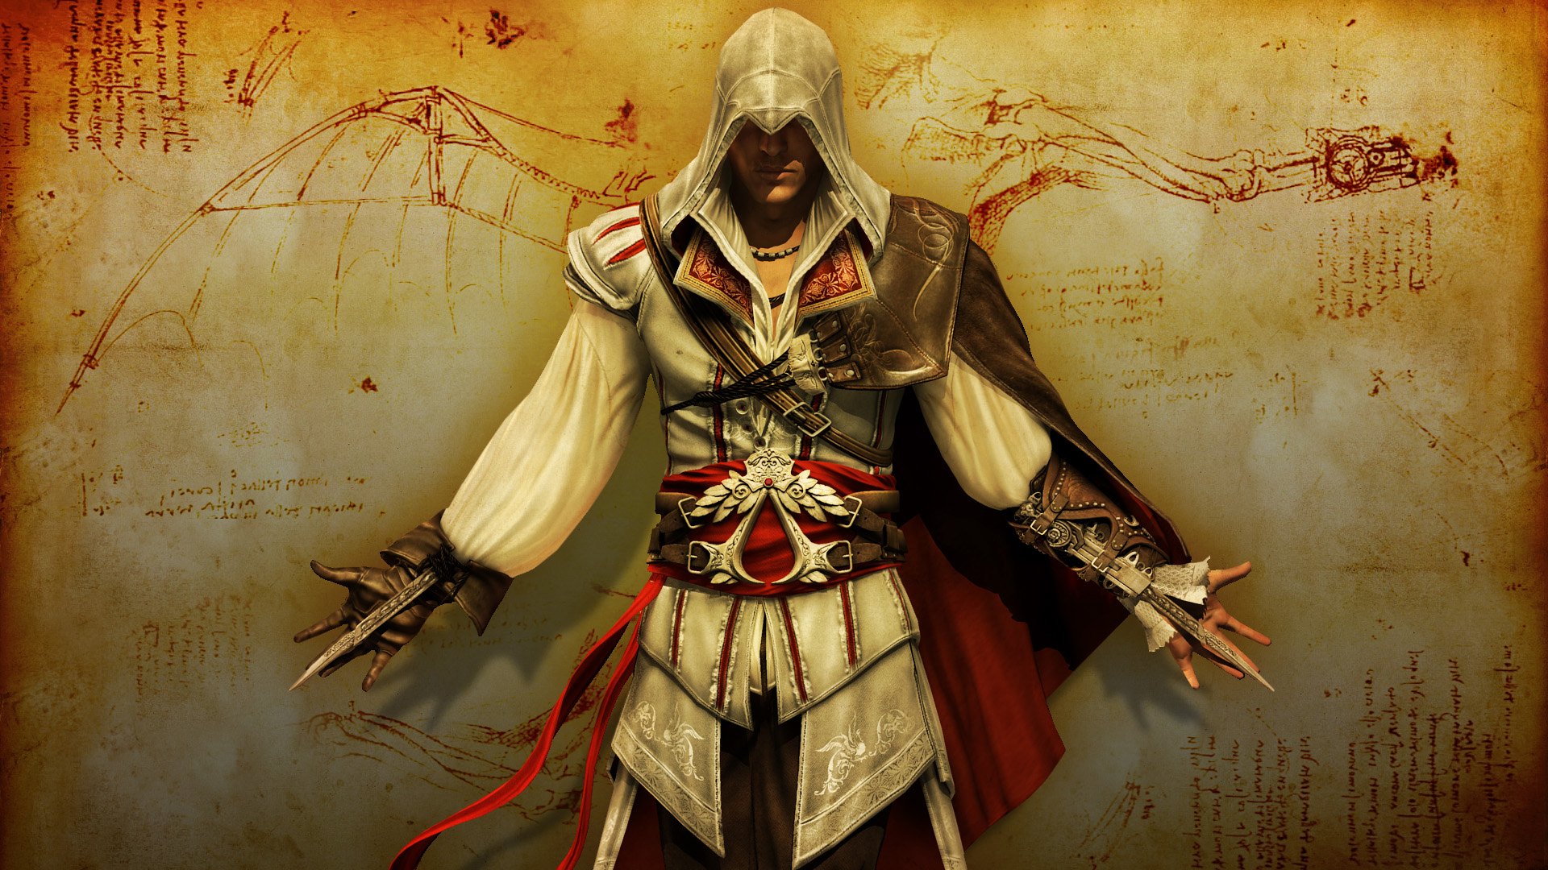
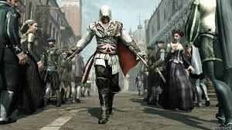
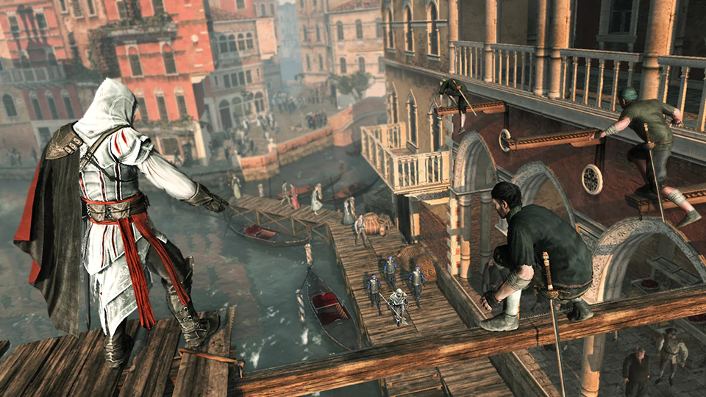
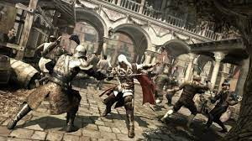
EVOLUTION
HOME
Assassin's Creed II is a 2009 action-adventure video game developed by Ubisoft Montréal and published by Ubisoft.It is the second major install in the Assassin's Creed series, and the sequel to 2007's Assassin's Creed. The game was first released on the PlayStation 3 and Xbox 360 in November 2009, and was later made available on Microsoft Windows in March 2010 and OS X in October 2010.
PC System requirements
Minimum
OS: Windows : XP/7/8/10
Processor: 1.8 GHz Intel Core2 Duo or 2.4 GHz AMD
Video: 256 MB DirectX 9.0.
RAM: 2 GB.
Storage: 8 GB.
Sound Card: DirectX 9.0c–compliant sound card.
Denuwan(WHDR) creation
The game's plot is set in a fictional history of real-world events and follows the millennia-old struggle between the Assassins, who fight to preserve peace and free will, and the Templars, who desire peace through control. The framing story is set in the 21st century and follows Desmond Miles as he relives the genetic memories of his ancestor, Ezio Auditore da Firenze, to uncover the mysteries left behind by an ancient race known as the First Civilization in the hope of ending the Assassin-Templar conflict. The main narrative takes place at the height of the Renaissance in Italy from 1476 to 1499, and follows Ezio's journey as an Assassin while seeking revenge against those responsible for the death of his father and brothers. Gameplay focuses on using Ezio's combat, stealth, and parkour abilities to defeat enemies and explore the environment. The game features a large open world comprising several Italian cities, including Florence, Venice, Monteriggioni, San Gimignano, and Forlì, all of which have been accurately recreated to fit the game's historical setting.

Slide 12
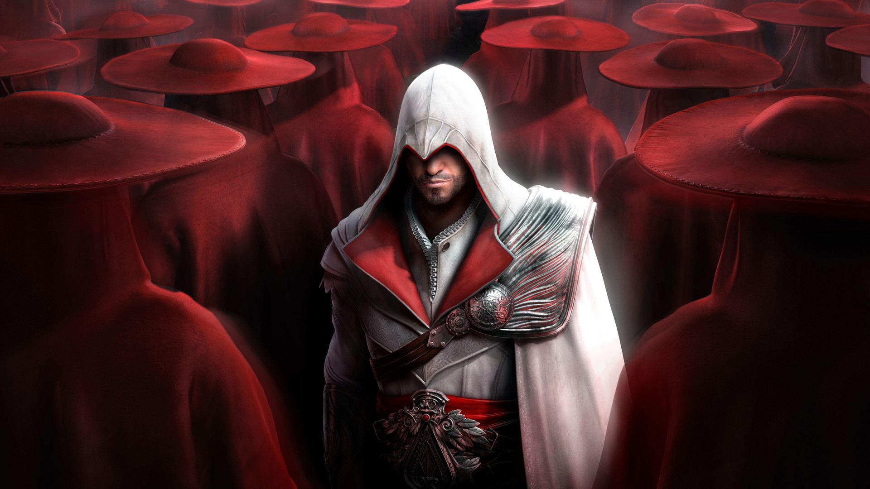
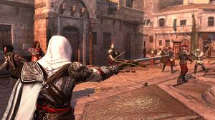
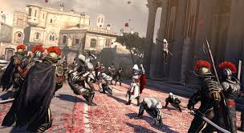
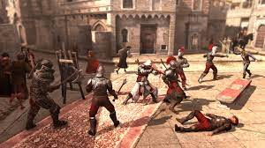
EVOLUTION
HOME
Assassin's Creed: Brotherhood is a 2010 action-adventure video game developed by Ubisoft Montreal and published by Ubisoft.It is the third major install in the Assassin's Creed series, and the second chapter in the "Ezio Trilogy", as a direct sequel to 2009's Assassin's Creed II. The game was first released on the PlayStation 3 and Xbox 360 in November and December 2010 and was later made available on Microsoft Windows in March and June 2011
PC System requirements
Minimum
OS: Windows : XP/7/8/10
Processor: 1.8 GHz Intel Core2 Duo or 2.4 GHz AMD
Video: 256 MB DirectX 9.0.
RAM: 2 GB.
Storage: 8 GB.
Sound Card: DirectX 9.0c–compliant sound card.
Denuwan(WHDR) creation
The plot is set in a fictional history of real-world events and follows the millennia-old struggle between the Assassins, who fight to preserve peace and free will, and the Templars, who desire peace through control. The framing story is set in the 21st century and features series protagonist Desmond Miles who, using a machine known as the Animus, relives the memories of his Assassin ancestor, Ezio Auditore da Firenze, to find a way to avert the 2012 apocalypse. The main story takes place during the Italian Wars, spanning the years 1500–1507, and continues from the events of Assassin's Creed II, as Ezio takes the fight against the Templars (led by the powerful Borgia family) to Rome, where he attempts to rebuild the Assassin Brotherhood in Italy and liberate the city from the Borgias' control.
Brotherhood features an open world and is played from the third-person perspective, with a primary focus on using Desmond's and Ezio's combat, climbing and stealth abilities to eliminate targets and explore the environment.

Slide 13
Assassin's Creed II is a 2009 action-adventure video game developed by Ubisoft Montréal and published by Ubisoft.It is the second major install in the Assassin's Creed series, and the sequel to 2007's Assassin's Creed. The game was first released on the PlayStation 3 and Xbox 360 in November 2009, and was later made available on Microsoft Windows in March 2010 and OS X in October 2010.
PC System requirements
Minimum
OS: Windows 7/8/10
Processor: 1.8 GHz Intel Core2 Duo or 2.4 GHz AMD
Video: 256 MB DirectX 9.0.
RAM: 2 GB.
Storage: 8 GB.
Sound Card: DirectX 9.0c–compliant sound card.
HOME
The game's plot is set in a fictional history of real-world events and follows the millennia-old struggle between the Assassins, who fight to preserve peace and free will, and the Templars, who desire peace through control. The framing story is set in the 21st century and follows Desmond Miles as he relives the genetic memories of his ancestor, Ezio Auditore da Firenze, to uncover the mysteries left behind by an ancient race known as the First Civilization in the hope of ending the Assassin-Templar conflict. The main narrative takes place at the height of the Renaissance in Italy from 1476 to 1499, and follows Ezio's journey as an Assassin while seeking revenge against those responsible for the death of his father and brothers. Gameplay focuses on using Ezio's combat, stealth, and parkour abilities to defeat enemies and explore the environment. The game features a large open world comprising several Italian cities, including Florence, Venice, Monteriggioni, San Gimignano, and Forlì, all of which have been accurately recreated to fit the game's historical setting.
Denuwan(WHDR) creation

Slide 14
Assassin's Creed is an action-adventure game developed by Ubisoft Montreal and published by Ubisoft. It is the first install in the Assassin's Creed series. The video game was released for PlayStation 3 and Xbox 360 in November 2007. A Microsoft Windows version titled Assassin's Creed: Director's Cut Edition containing additional content was released in April 2008.
PC System requirements
Minimum
OS: Windows :Vista/XP/7/8/10
Processor: Dual core 2.6GHZ/1.8 GHz Intel Core2 Duo or 2.4 GHz AMD
Video: 256 MB DirectX 9.0.
RAM: 2 GB.
Storage: 8 GB.
Sound Card: DirectX 9.0c–compliant sound card.
HOME
The plot is set in a fictional history of real-world events, taking place primarily during the Third Crusade in the Holy Land in 1191. The player character is a modern-day man named Desmond Miles who, through a machine called the Animus, relives the genetic memories of his ancestor, Altaïr Ibn-La'Ahad. Through this plot device, details emerge about a millennia-old struggle between two factions: the Assassin Brotherhood (inspired by the real-life Order of Assassins), who fight to preserve peace and free will, and the Templar Order (inspired by the Knights Templar military order), who seek to establish peace through order and control. Both factions fight over powerful artifacts of mysterious origins known as Pieces of Eden to gain an advantage over each other. The 12th-century portion of the story follows Altaïr, an Assassin, who embarks on a quest to regain his honour after botching a mission to recover one such artifact from the Templars; he does so by finding and assassinating nine targets across the Holy Land.
Denuwan(WHDR) creation

Slide 15
Assassin's Creed: Brotherhood is a 2010 action-adventure video game developed by Ubisoft Montreal and published by Ubisoft.It is the third major install in the Assassin's Creed series, and the second chapter in the "Ezio Trilogy", as a direct sequel to 2009's Assassin's Creed II. The game was first released on the PlayStation 3 and Xbox 360 in November and December 2010 and was later made available on Microsoft Windows in March and June 2011
PC System requirements
Minimum
OS: Windows 7/8/10
Processor: 1.8 GHz Intel Core2 Duo or 2.4 GHz AMD
Video: 256 MB DirectX 9.0.
RAM: 2 GB.
Storage: 8 GB.
Sound Card: DirectX 9.0c–compliant sound card.
HOME
The plot is set in a fictional history of real-world events and follows the millennia-old struggle between the Assassins, who fight to preserve peace and free will, and the Templars, who desire peace through control. The framing story is set in the 21st century and features series protagonist Desmond Miles who, using a machine known as the Animus, relives the memories of his Assassin ancestor, Ezio Auditore da Firenze, to find a way to avert the 2012 apocalypse. The main story takes place during the Italian Wars, spanning the years 1500–1507, and continues from the events of Assassin's Creed II, as Ezio takes the fight against the Templars (led by the powerful Borgia family) to Rome, where he attempts to rebuild the Assassin Brotherhood in Italy and liberate the city from the Borgias' control.
Brotherhood features an open world and is played from the third-person perspective, with a primary focus on using Desmond's and Ezio's combat, climbing and stealth abilities to eliminate targets and explore the environment.

Slide 16
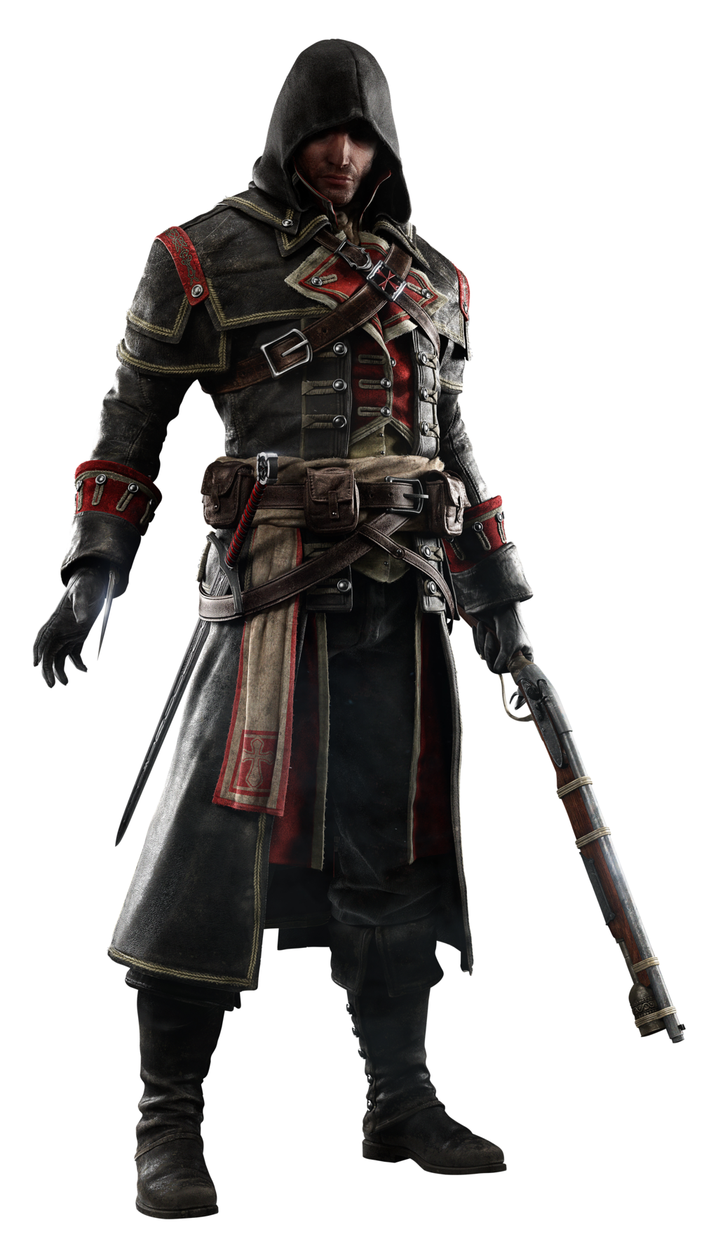
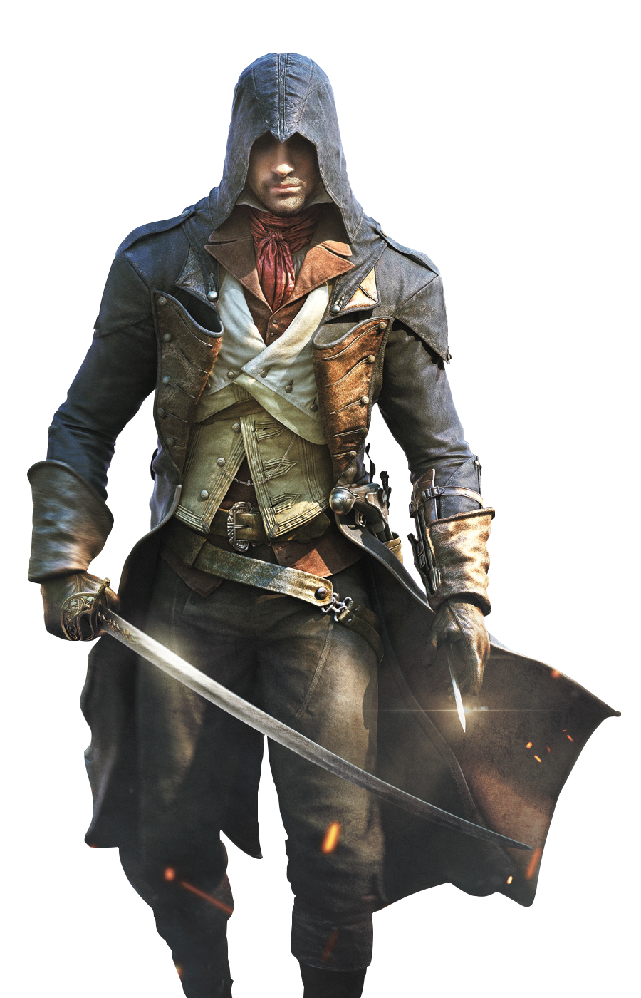
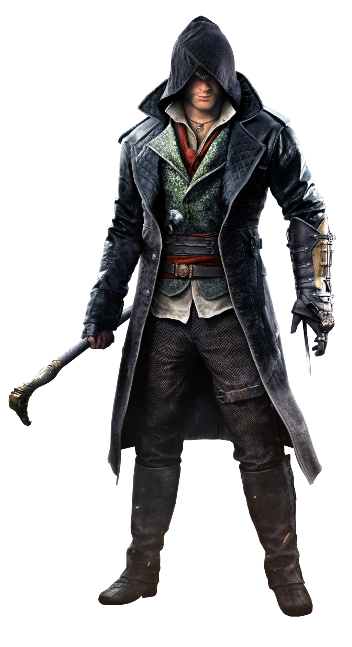

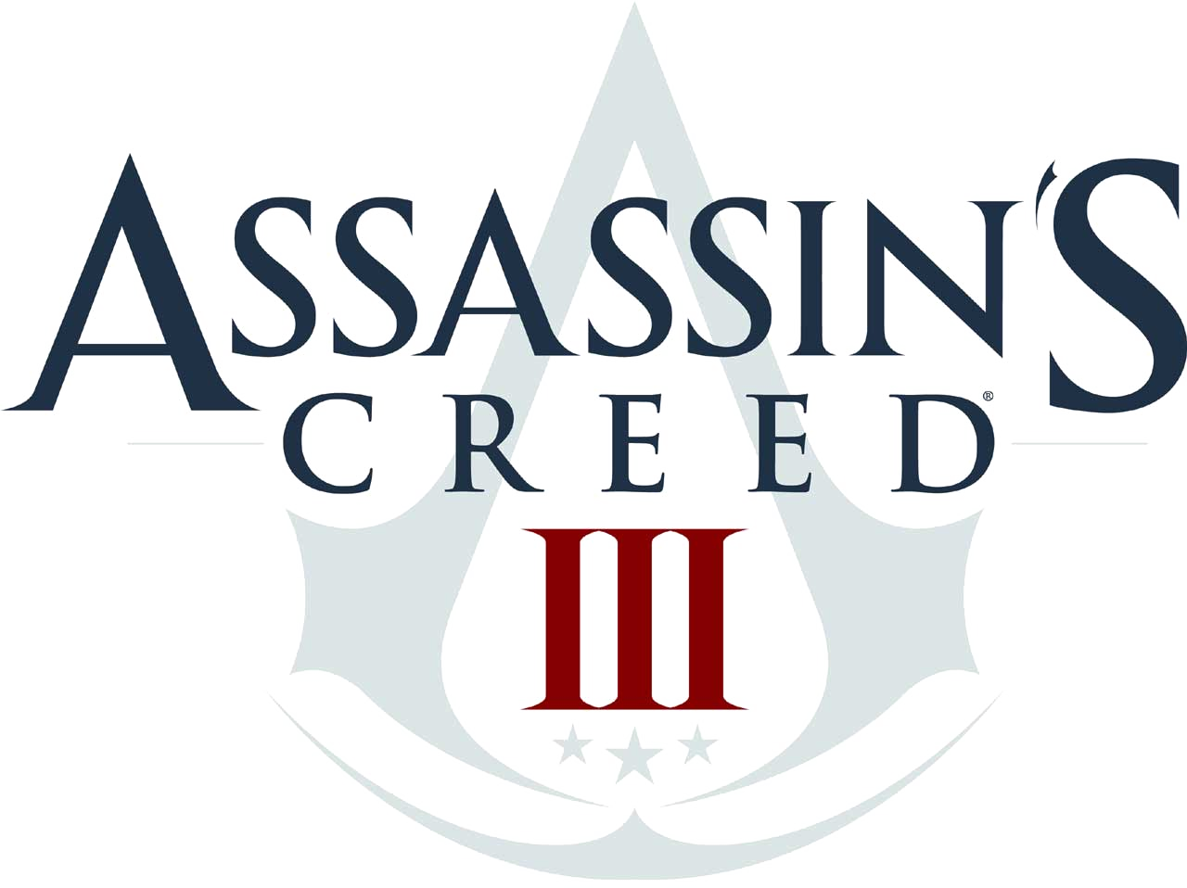

EVOLUTION
HOME
Denuwan(WHDR) creation

Slide 17
EVOLUTION
HOME
Denuwan(WHDR) creation

Slide 18
EVOLUTION
HOME
Denuwan(WHDR) creation

Slide 19
EVOLUTION
HOME
Denuwan(WHDR) creation

Slide 20
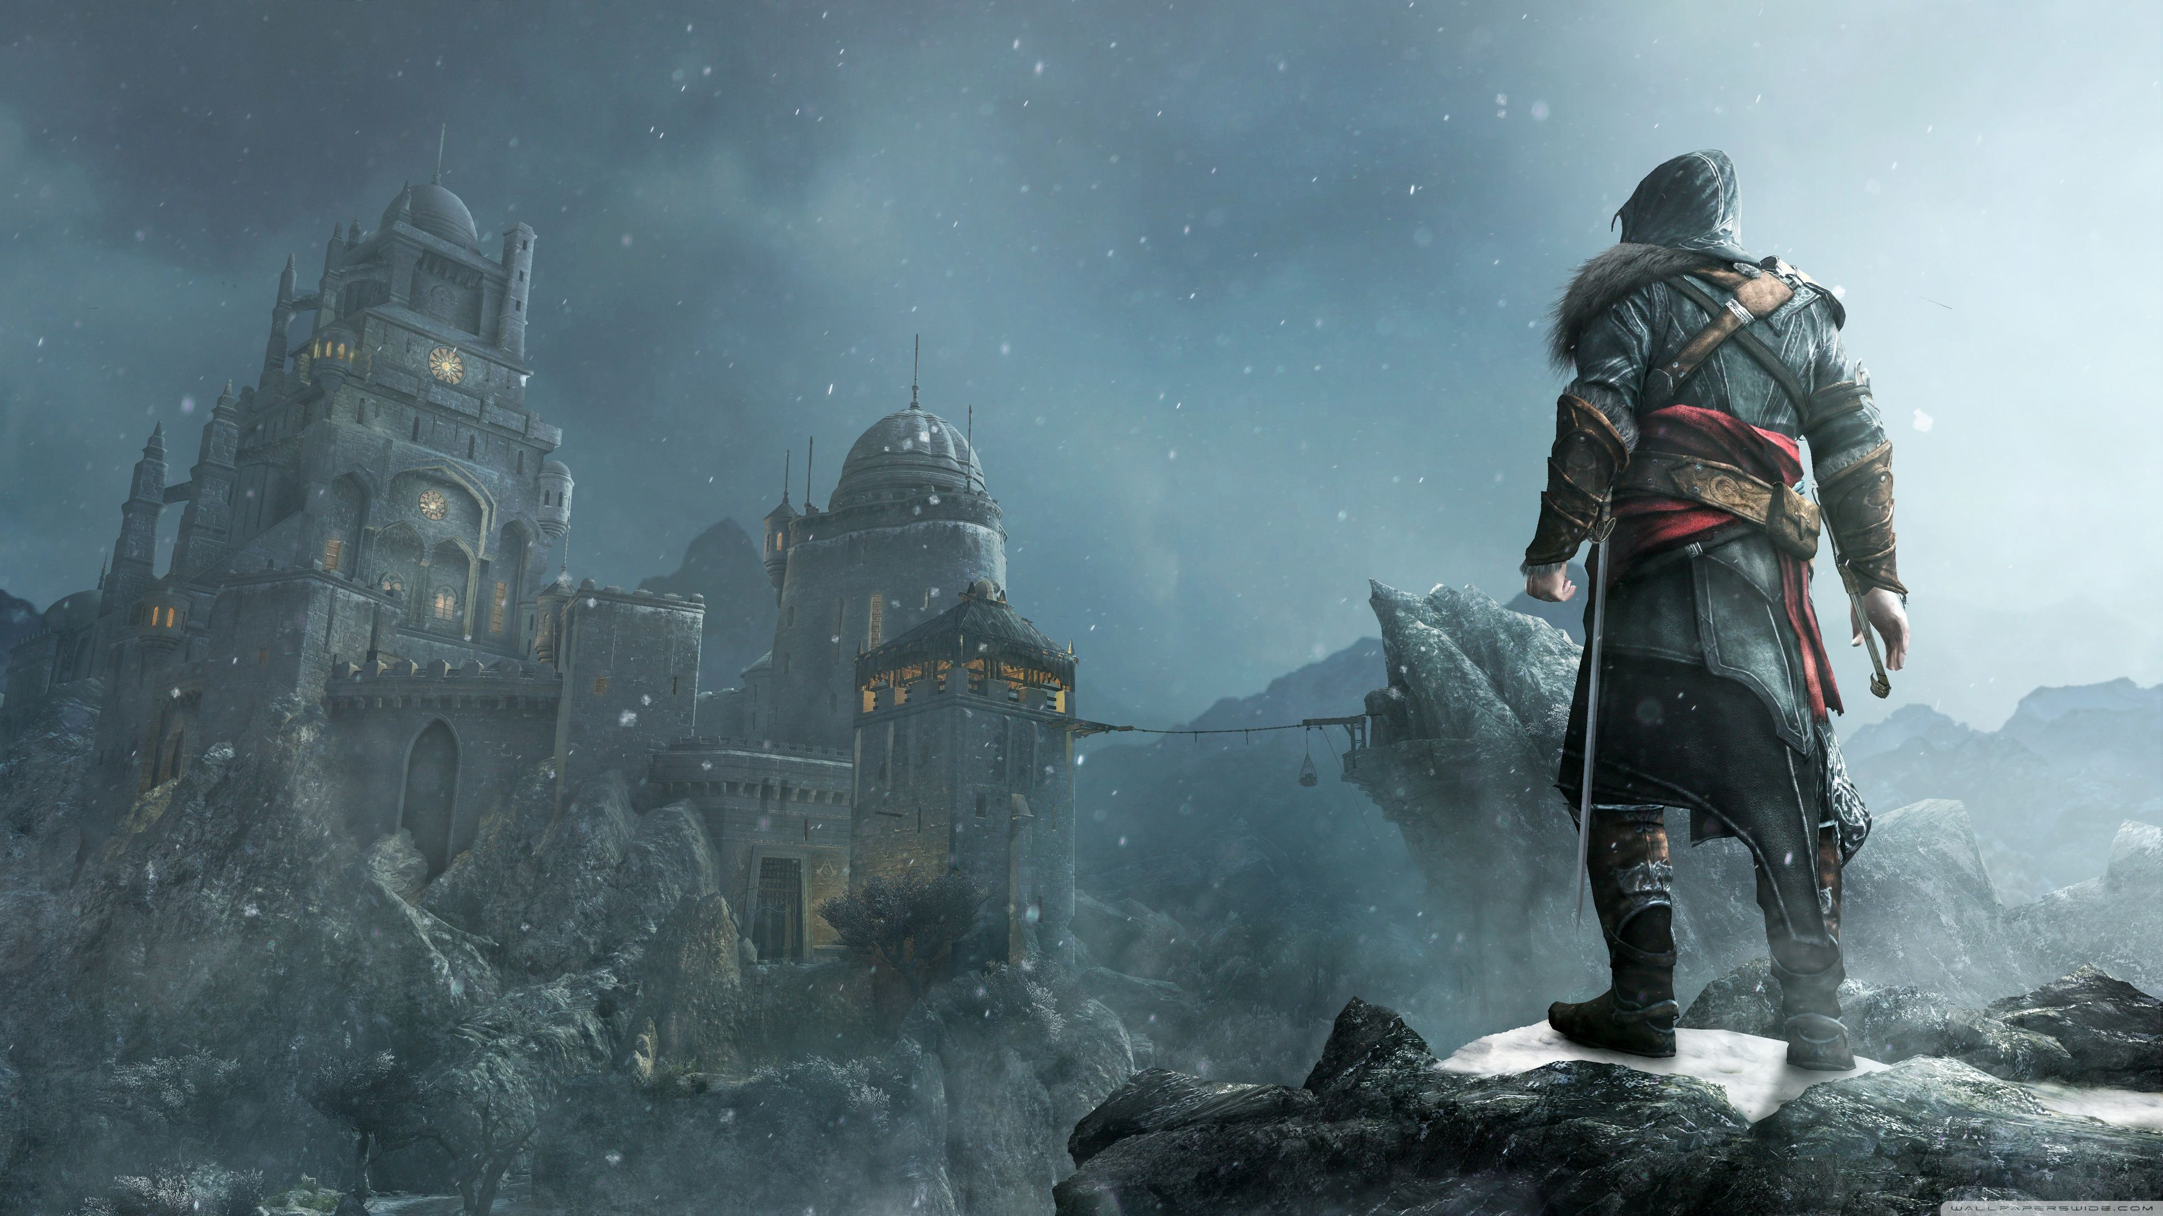
EVOLUTION
HOME
Assassin's Creed: Revelations is a 2011 action-adventure video game developed by Ubisoft Montreal and published by Ubisoft. It is the fourth major install in the Assassin's Creed series, and a direct sequel to 2010's Assassin's Creed: Brotherhood, concluding the "Ezio Trilogy". The game was released on PlayStation 3, Xbox 360, and Microsoft Windows in November and December 2011.
PC System requirements
Minimum
OS: Windows : XPsp2/7sp1/8/10
Processor: 1.8 GHz Intel Core2 Duo or 2.4 GHz AMD
Video: 256 MB DirectX 9.0.
RAM: 2 GB.
Storage: 8 GB.
Sound Card: DirectX 9.0c–compliant sound card.
Denuwan(WHDR) creation
The plot is set in a fictional history of real-world events and follows the millennia-old struggle between the Assassins, who fight to preserve peace and free will, and the Templars, who desire peace through control. The framing story is set in the 21st century and features the series protagonist Desmond Miles who, after falling into a coma during the events of Brotherhood, must relive the memories of his ancestors through the Animus device in order to awaken and find a way to avert the 2012 apocalypse. The main story spans the years 1511–1512 and follows an aged Ezio Auditore da Firenze (the protagonist of the trilogy) as he travels to Constantinople to find five keys needed to unlock a library built by Altaïr Ibn-LaʼAhad (the protagonist of the first game in the series). In Constantinople, Ezio becomes caught in a war of succession for the Ottoman throne and must unravel a conspiracy by the Byzantine Templars, who are attempting to reclaim control of the city and acquire the keys to Altaïr's library themselves.

Slide 21
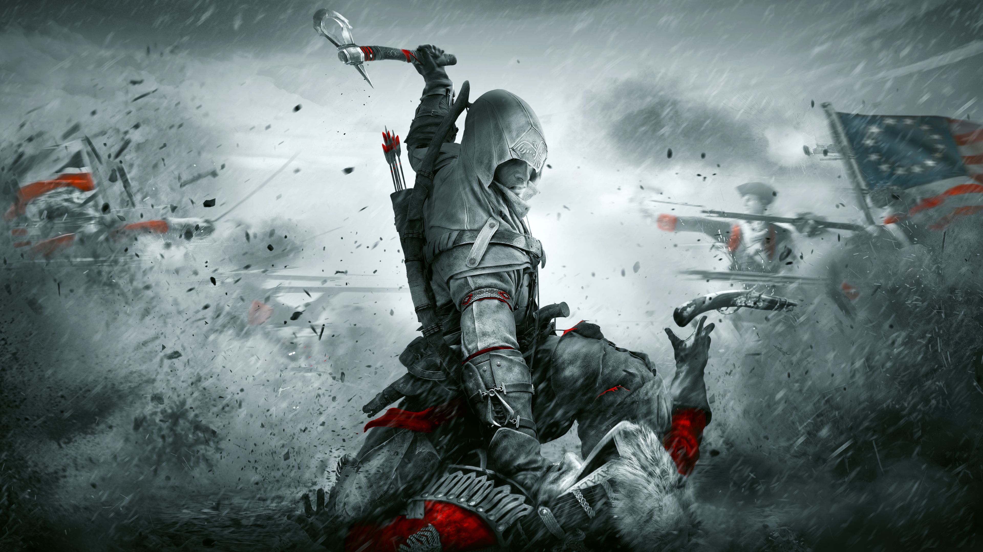
EVOLUTION
HOME
Assassin's Creed III is a 2012 action-adventure video game developed by Ubisoft Montreal and published by Ubisoft. It is the fifth major install in the Assassin's Creed series, and a direct sequel to 2011's Assassin's Creed: Revelations. The game was released worldwide for PlayStation 3 and Xbox 360, beginning in North America on October 30, 2012, with a Wii U and Microsoft Windows release in November 2012.
PC System requirements
Minimum
OS: Windows : XPsp2/7sp1/8/10
Processor: 2.66 GHz Intel Core2 Duo or 2.6 GHz AMD
Video: 512 MB DirectX 10
RAM: 2 GB.
Storage: 17 GB.
Sound Card: DirectX 10-Shader model 4.0.
Denuwan(WHDR) creation
The plot is set in a fictional history of real-world events and follows the millennia-old struggle between the Assassins, who fight to preserve peace and free will, and the Templars, who desire peace through control. The framing story is set in the 21st century and features series protagonist Desmond Miles who, with the aid of a machine known as the Animus, relives the memories of his ancestors to find a way to avert the 2012 apocalypse. The main narrative is set in 18th-century Colonial America from 1754 to 1783, and follows two characters whose stories are interconnected: Haytham Kenway, a British Templar who attempts to build a presence for his Order in the colonies during the French and Indian War; and Ratonhnhaké:ton / Connor, Haytham's half-Mohawk son, who becomes an Assassin to protect his people's lands and avenge his mother's death, and battles the Templars' attempts to influence the outcome of the American Revolution for their own benefit.

Slide 22
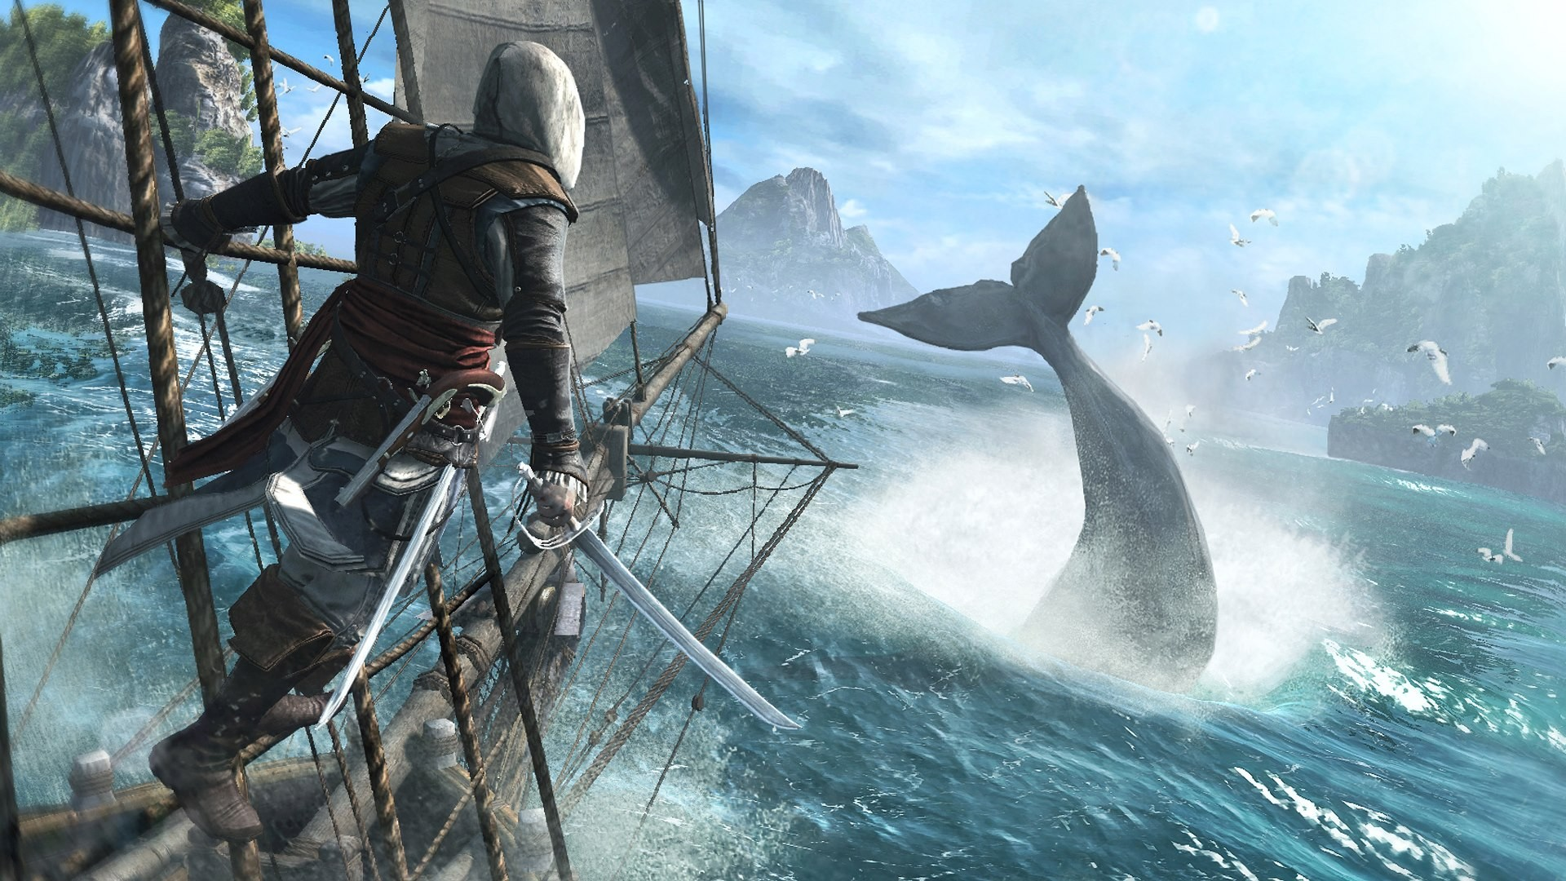
EVOLUTION
HOME
Assassin's Creed IV: Black Flag is a 2013 action-adventure video game developed by Ubisoft Montreal and published by Ubisoft. It is the sixth major install in the Assassin's Creed series. Its historical timeframe precedes that of Assassin's Creed III (2012), but its modern-day sequences succeed III's own. Black Flag was originally released for PlayStation 3, Xbox 360, and Wii U in October 2013 and a month later for PlayStation 4, Windows, and Xbox One.
PC System requirements
Minimum
OS: Windows : XPsp2/7sp1/8/10
Processor: 2.66 GHz Intel Core2 Duo or 2.6 GHz AMD
Video: GTX 260/AMD HD 4870(512 MB VRAM)
RAM: 2 GB.
Storage: 30 GB.
Sound Card: DirectX 10-Shader model 4.0.
Denuwan(WHDR) creation

Slide 23
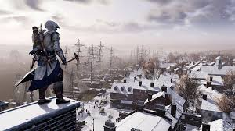
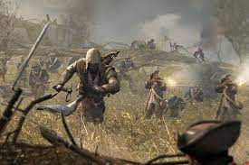
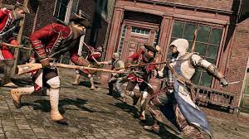
Assassin's Creed III is a 2012 action-adventure video game developed by Ubisoft Montreal and published by Ubisoft. It is the fifth major install in the Assassin's Creed series, and a direct sequel to 2011's Assassin's Creed: Revelations. The game was released worldwide for PlayStation 3 and Xbox 360, beginning in North America on October 30, 2012, with a Wii U and Microsoft Windows release in November 2012.
PC System requirements
Minimum
OS: Windows : XPsp2/7sp1/8/10
Processor: 2.66 GHz Intel Core2 Duo or 2.6 GHz AMD
Video: 512 MB DirectX 10
RAM: 2 GB.
Storage: 17 GB.
Sound Card: DirectX 10-Shader model 4.0.
HOME
The plot is set in a fictional history of real-world events and follows the millennia-old struggle between the Assassins, who fight to preserve peace and free will, and the Templars, who desire peace through control. The framing story is set in the 21st century and features series protagonist Desmond Miles who, with the aid of a machine known as the Animus, relives the memories of his ancestors to find a way to avert the 2012 apocalypse. The main narrative is set in 18th-century Colonial America from 1754 to 1783, and follows two characters whose stories are interconnected: Haytham Kenway, a British Templar who attempts to build a presence for his Order in the colonies during the French and Indian War; and Ratonhnhaké:ton / Connor, Haytham's half-Mohawk son, who becomes an Assassin to protect his people's lands and avenge his mother's death, and battles the Templars' attempts to influence the outcome of the American Revolution for their own benefit.
Denuwan(WHDR) creation

Slide 24
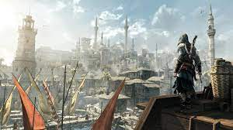
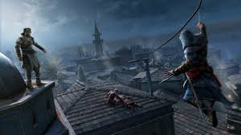
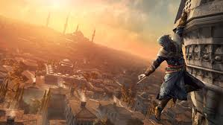
Assassin's Creed: Revelations is a 2011 action-adventure video game developed by Ubisoft Montreal and published by Ubisoft. It is the fourth major install in the Assassin's Creed series, and a direct sequel to 2010's Assassin's Creed: Brotherhood, concluding the "Ezio Trilogy". The game was released on PlayStation 3, Xbox 360, and Microsoft Windows in November and December 2011.
PC System requirements
Minimum
OS: Windows : XPsp2/7sp1/8/10
Processor: 1.8 GHz Intel Core2 Duo or 2.4 GHz AMD
Video: 256 MB DirectX 9.0.
RAM: 2 GB.
Storage: 8 GB.
Sound Card: DirectX 9.0c–compliant sound card.
HOME
The plot is set in a fictional history of real-world events and follows the millennia-old struggle between the Assassins, who fight to preserve peace and free will, and the Templars, who desire peace through control. The framing story is set in the 21st century and features the series protagonist Desmond Miles who, after falling into a coma during the events of Brotherhood, must relive the memories of his ancestors through the Animus device in order to awaken and find a way to avert the 2012 apocalypse. The main story spans the years 1511–1512 and follows an aged Ezio Auditore da Firenze (the protagonist of the trilogy) as he travels to Constantinople to find five keys needed to unlock a library built by Altaïr Ibn-LaʼAhad (the protagonist of the first game in the series). In Constantinople, Ezio becomes caught in a war of succession for the Ottoman throne and must unravel a conspiracy by the Byzantine Templars, who are attempting to reclaim control of the city and acquire the keys to Altaïr's library themselves.
Denuwan(WHDR) creation

Slide 25
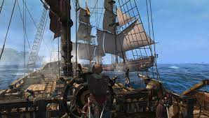

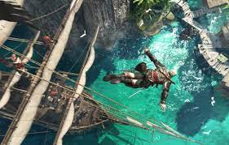
Assassin's Creed IV: Black Flag is a 2013 action-adventure video game developed by Ubisoft Montreal and published by Ubisoft. It is the sixth major install in the Assassin's Creed series. Its historical timeframe precedes that of Assassin's Creed III (2012), but its modern-day sequences succeed III's own. Black Flag was originally released for PlayStation 3, Xbox 360, and Wii U in October 2013 and a month later for PlayStation 4, Windows, and Xbox One.
PC System requirements
Minimum
OS: Windows : XPsp2/7sp1/8/10
Processor: 2.66 GHz Intel Core2 Duo or 2.6 GHz AMD
Video: GTX 260/AMD HD 4870(512 MB VRAM)
RAM: 2 GB.
Storage: 30 GB.
Sound Card: DirectX 10-Shader model 4.0.
HOME
The plot is set in a fictional history of real-world events and follows the millennia-old struggle between the Assassins, who fight to preserve peace and free will, and the Templars, who desire peace through control. The framing story is set in the 21st century and depicts the player as an employee of Abstergo Industries (a company used as a front by the modern-day Templars), who is manipulated into uncovering secrets related to the Assassin-Templar conflict and the precursor race known as the First Civilization. The main story is set in the West Indies during the Golden Age of Piracy from 1715 to 1722, and follows notorious Welsh pirate Edward Kenway, grandfather of Assassin's Creed III protagonist Ratonhnhaké:ton / Connor and father of antagonist Haytham Kenway, as he searches for fortune and a mythical location called the Observatory, which is sought by both the Assassins and the Templars. A major plot element concerns the attempted establishment of an independent Pirate republic in the Caribbean.
Denuwan(WHDR) creation

Slide 26
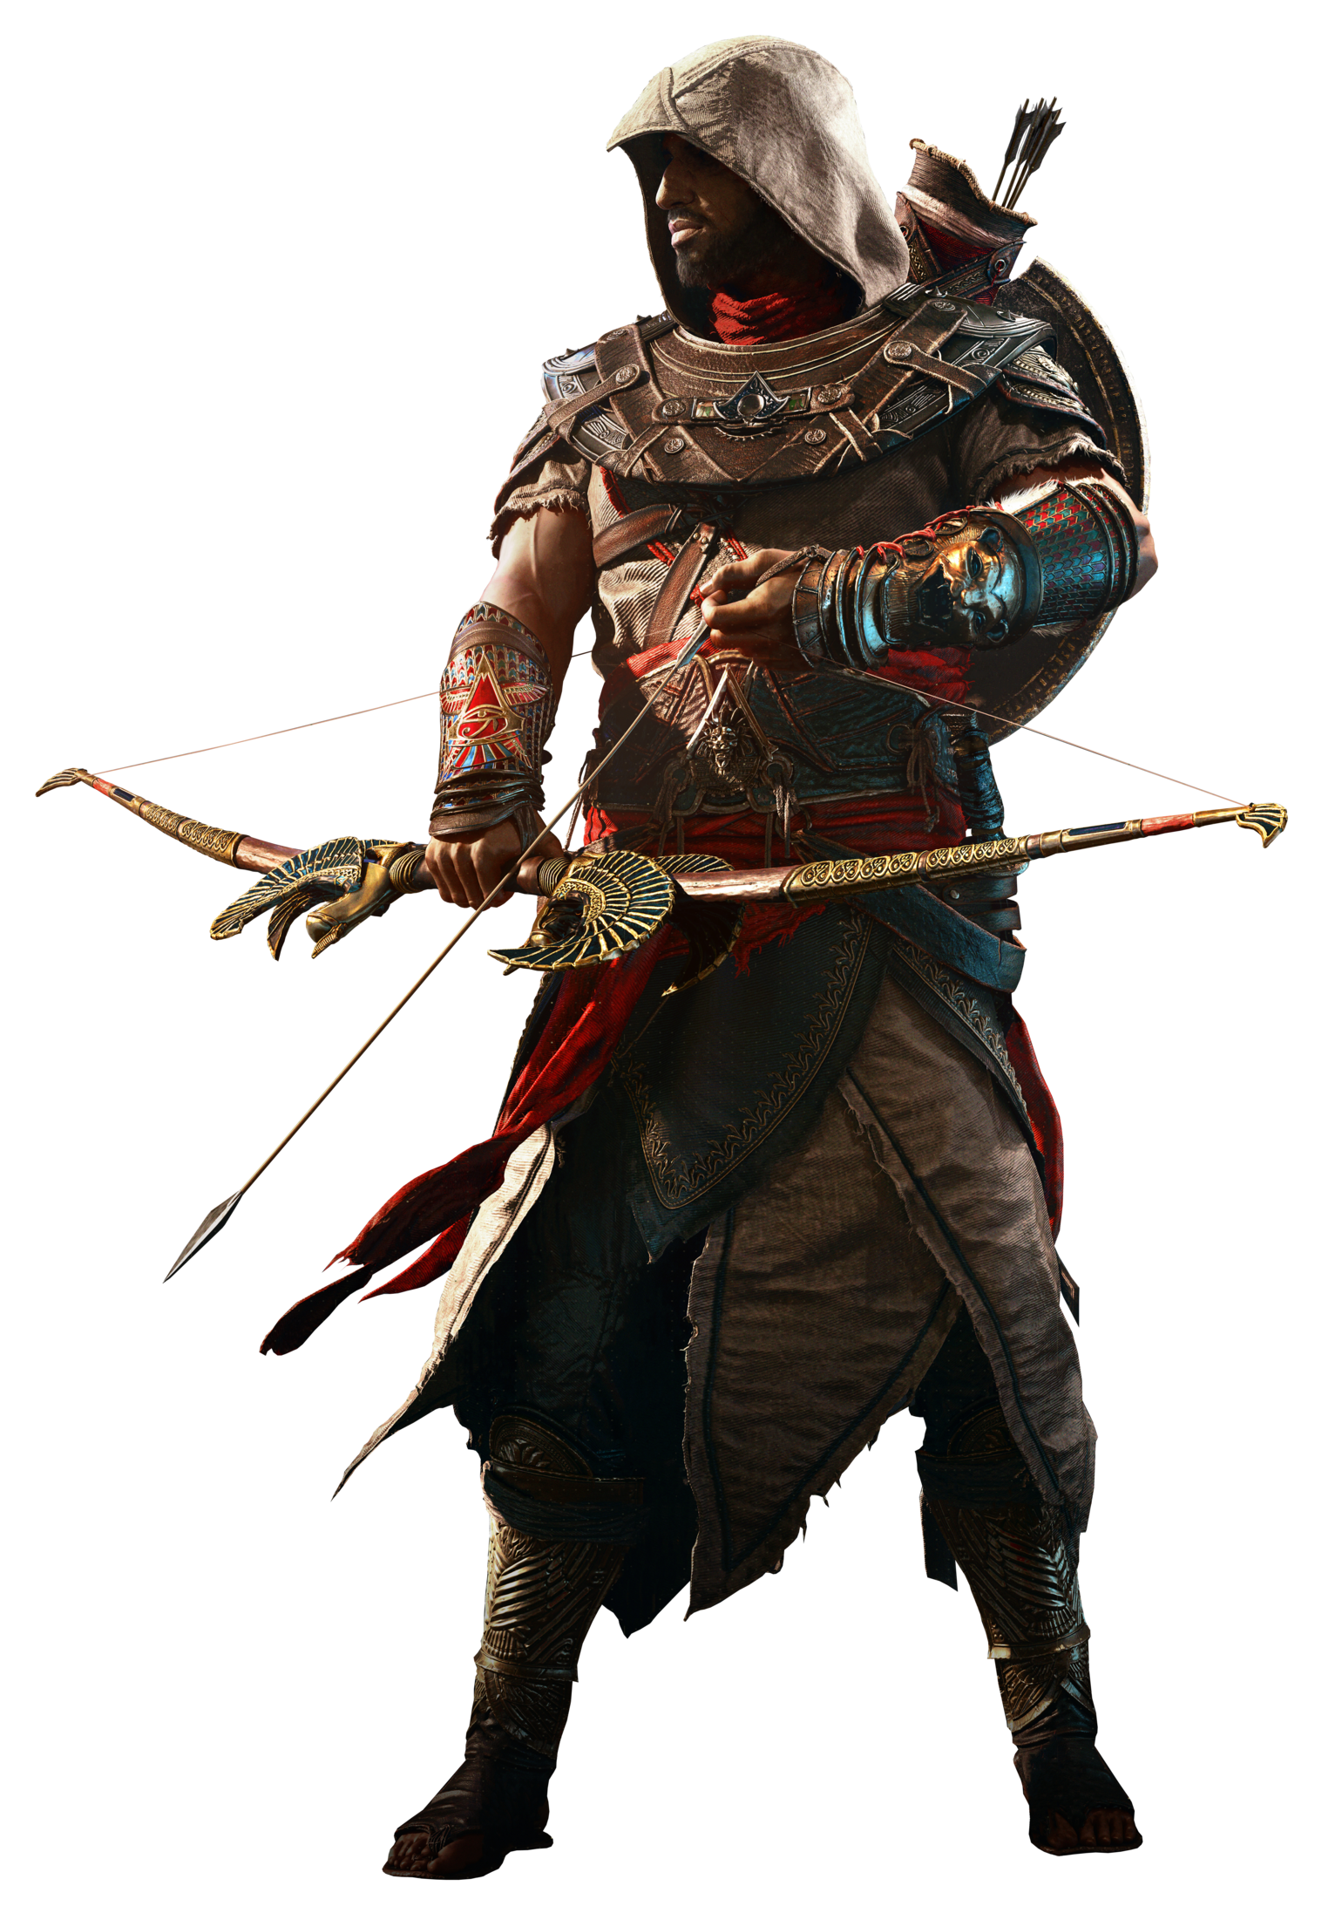
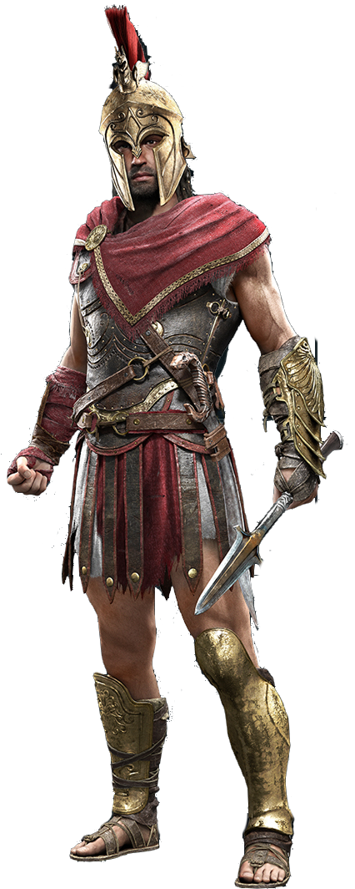
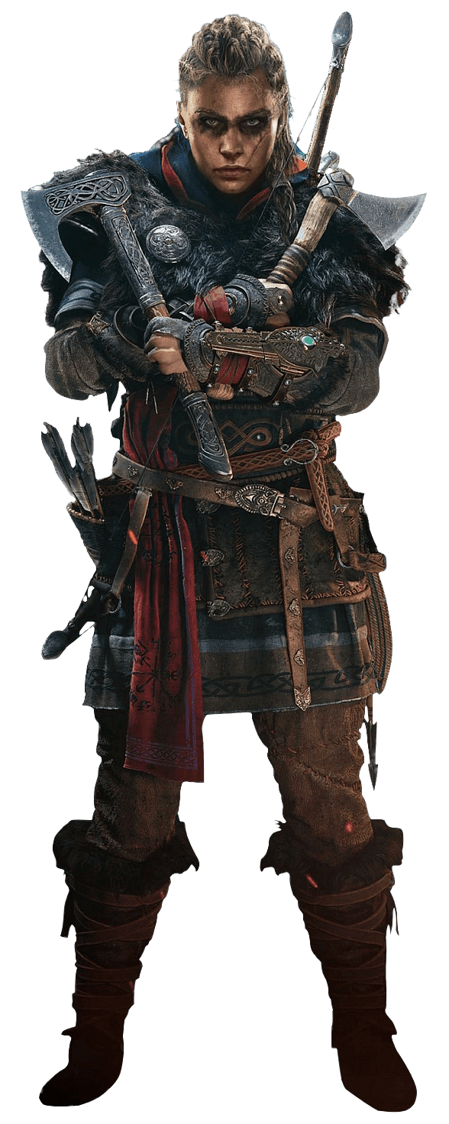

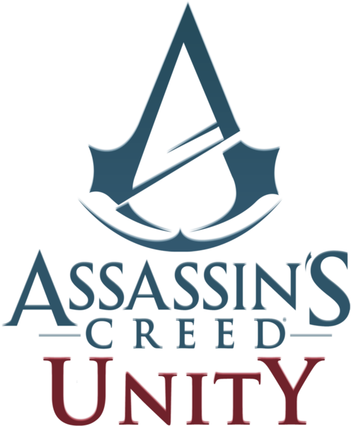
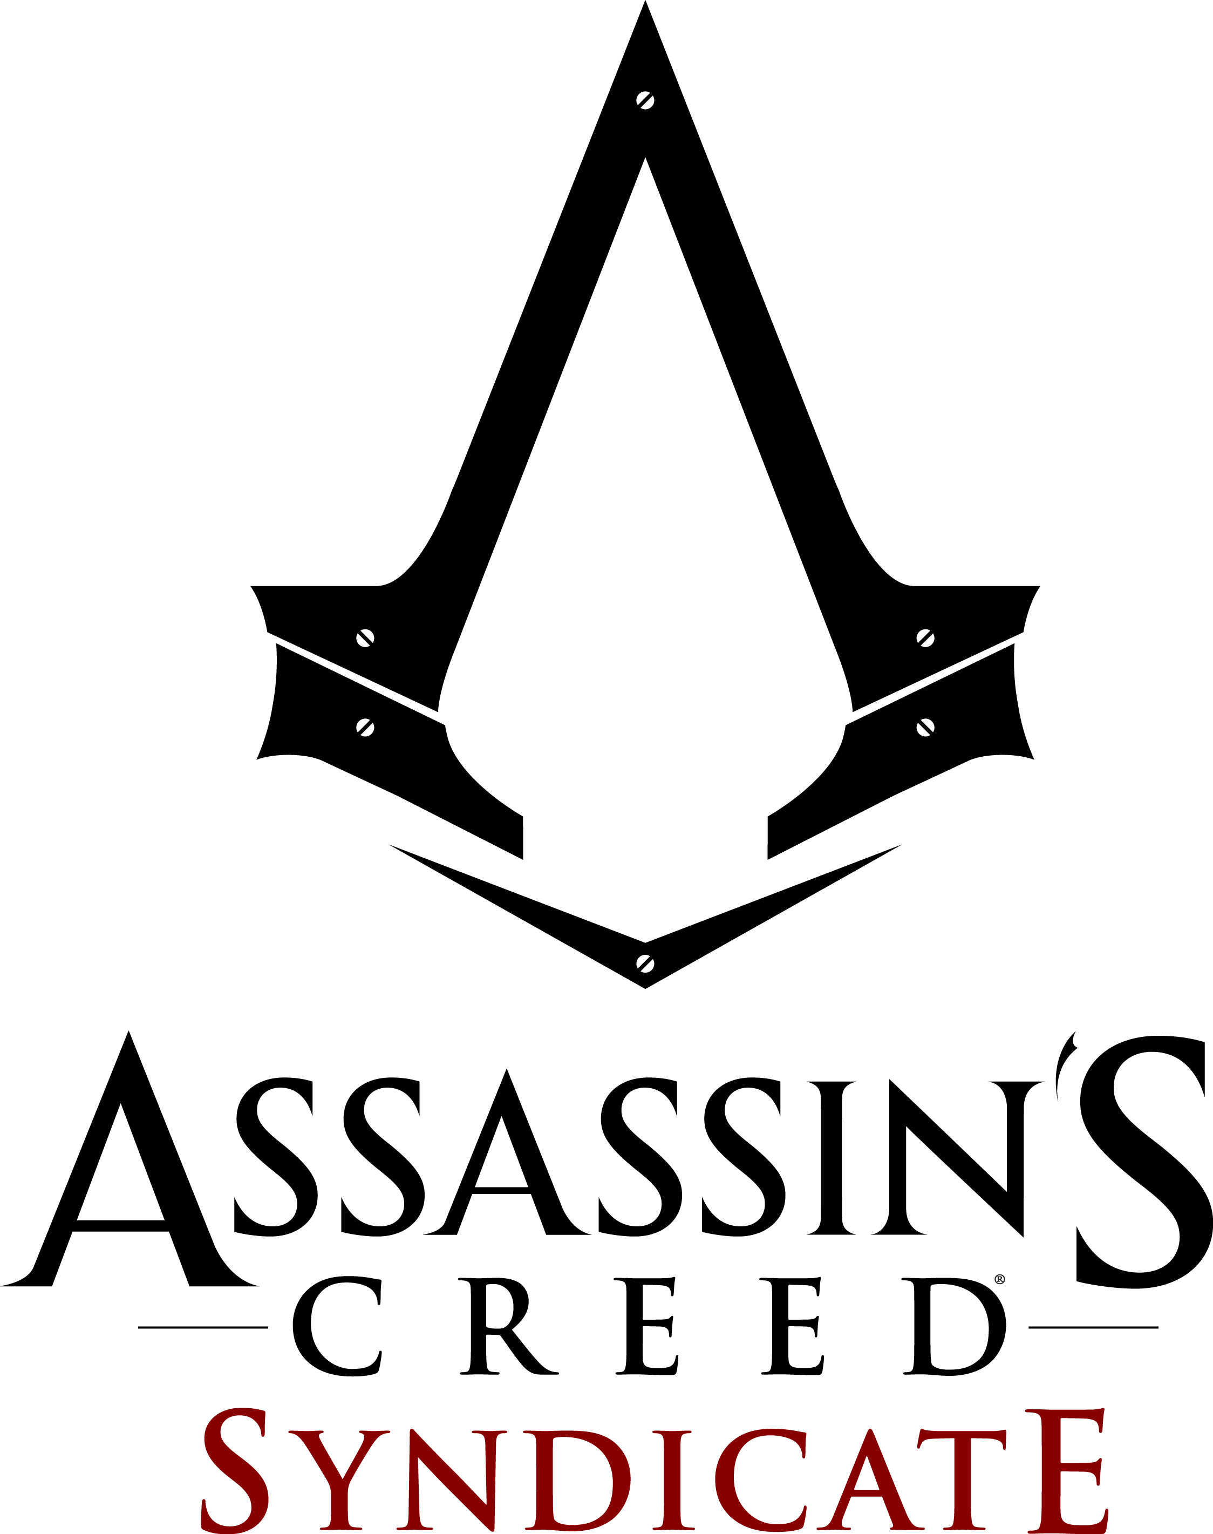
EVOLUTION
HOME
Denuwan(WHDR) creation

Slide 27
EVOLUTION
HOME
Denuwan(WHDR) creation

Slide 28
EVOLUTION
HOME
Denuwan(WHDR) creation

Slide 29
EVOLUTION
HOME
Denuwan(WHDR) creation

Slide 30
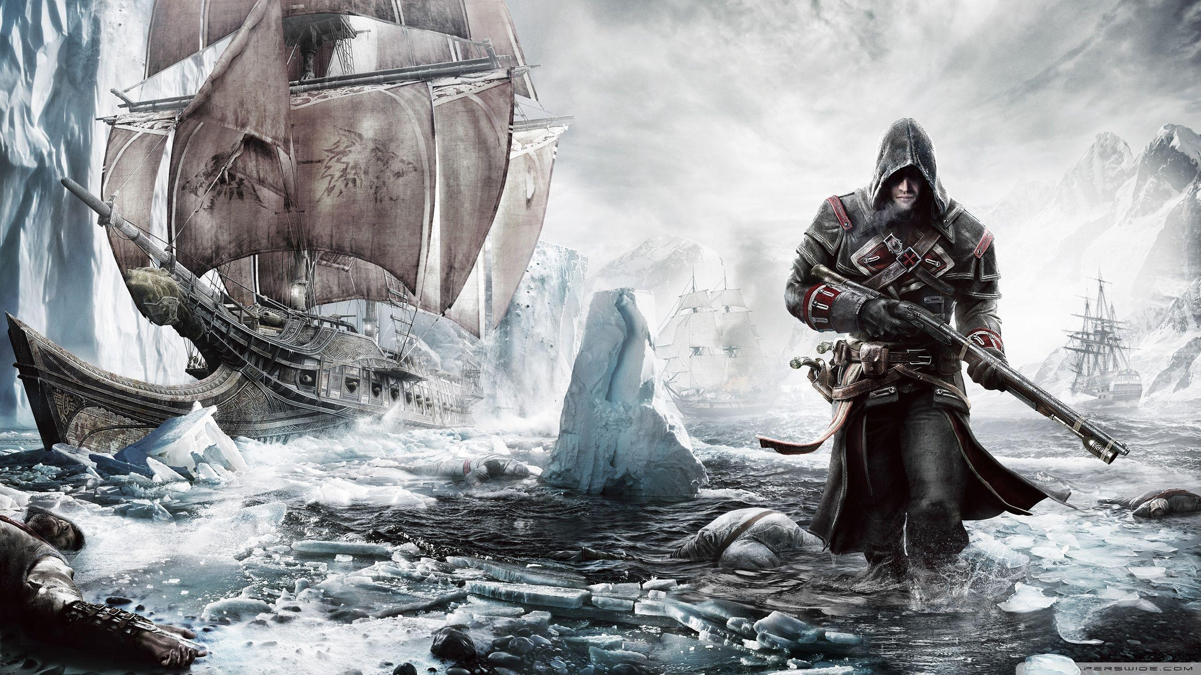
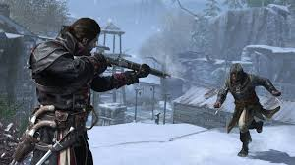
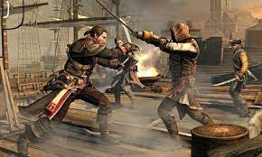
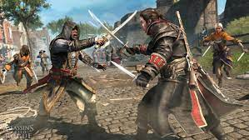
EVOLUTION
HOME
Assassin's Creed Rogue is a 2014 action-adventure video game developed by Ubisoft Sofia and published by Ubisoft. It is the seventh major install in the Assassin's Creed series, and is set between 2013's Assassin's Creed IV: Black Flag and 2012's Assassin's Creed III. It also has ties to Assassin's Creed Unity, which was released on the same day as Rogue. It is the last Assassin's Creed game to be developed for the seventh generation of consoles, being released for PlayStation 3 and Xbox 360 in November 2014, and for Windows in March 2015.
PC System requirements
Minimum
OS: Windows : 7sp1/8.1(64bit)/10
Processor: Intel core i5-2400s 3.1GHZ or AMD FX-6100 3.3GHZ
Video: GTX 56O AMD HD 6870(1GB VRAM Shader mode 4.0l).
RAM: 3 GB.
Storage: 12 GB.
Sound Card: DirectX 10c–compliant sound card..
Denuwan(WHDR) creation
The plot is set in a fictional history of real-world events and follows the millennia-old struggle between the Assassin Brotherhood, who fight to preserve peace and free will, and the Templar Order, who desire peace through control. The framing story is set during the 21st century and depicts the player as an employee of Abstergo Industries (a company used as a front by the modern-day Templars), who uncovers various secrets about the Assassin-Templar conflict while attempting to fix the company's servers. The main plot is set before and during the French and Indian War from 1752 to 1760, and follows Shay Patrick Cormac, an Irish American privateer and Assassin, who defects to the Templars and helps them hunt down members of his former Brotherhood after becoming disillusioned with their tactics. Gameplay in Rogue is very similar to that of Black Flag with a mixture of ship-based naval exploration and third-person land-based exploration, though some new features have been added.

Slide 31
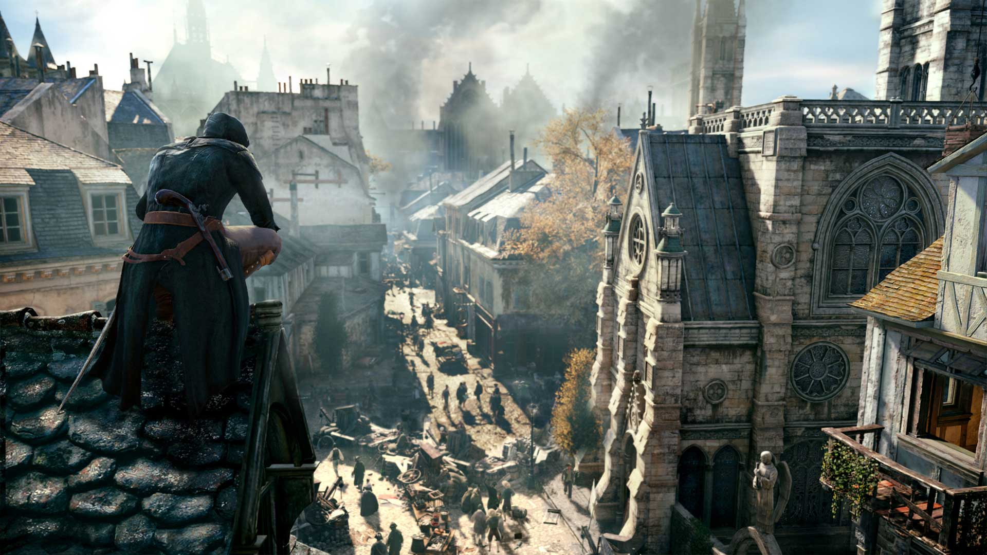

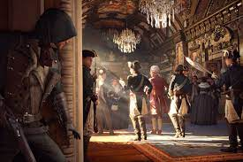
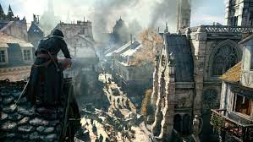
EVOLUTION
HOME
Assassin's Creed Unity is an action-adventure video game developed by Ubisoft Montreal and published by Ubisoft. It was released in November 2014 for PlayStation 4, Windows, and Xbox One, and in December 2020 for Stadia.[1] It is the eighth major install in the Assassin's Creed series, and the successor to 2013's Assassin's Creed IV: Black Flag. It also has ties to Assassin's Creed Rogue, which was released for the previous generation consoles on the same day as Unity.
PC System requirements
Minimum
OS: Windows : 7/8.1/10(64bit)
Processor: Intel core i5-2500 3.3GHZ or AMD FX-6350 4.0GHZ
Video: GTX 660 AMD R9 270(2GB VRAM Shader mode 5.0l).
RAM: 6 GB.
Storage: 50 GB.
Sound Card: DirectX 11c–compliant sound card.
Denuwan(WHDR) creation
The plot is set in a fictional history of real-world events and follows the millennia-old struggle between the Assassins, who fight to preserve peace and free will, and the Templars, who desire peace through control. The framing story is set in the 21st century and features an unidentified and unseen protagonist, who joins the Assassins as an initiate to help them locate the corpse of an 18th-century Templar Grand Master. The main story is set in Paris during the French Revolution from 1789 to 1794, and follows Assassin Arno Dorian and his efforts to expose the true powers behind the Revolution, while seeking revenge against those responsible for his adoptive father's murder. Unity retains the series' third-person open world exploration as well as introducing a revamped combat, parkour, and stealth systems. The game also introduces cooperative multiplayer to the Assassin's Creed series, letting up to four players engage in narrative-driven missions and explore the open world map.

Slide 32
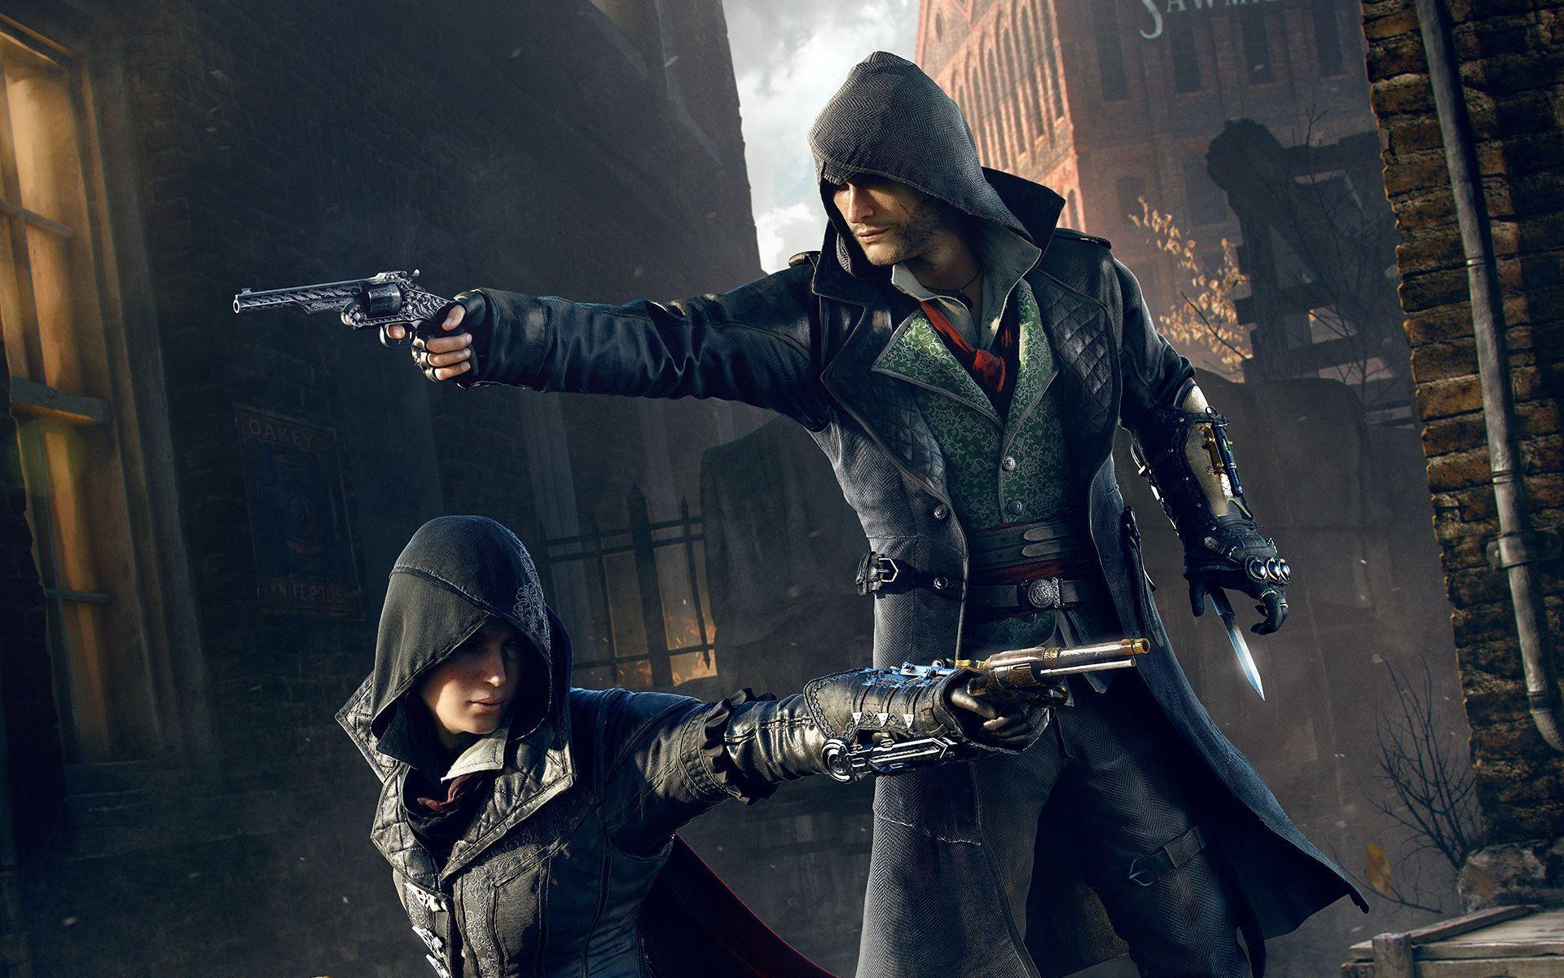
EVOLUTION
HOME
Assassin's Creed Syndicate is an action-adventure video game developed by Ubisoft Quebec and published by Ubisoft. It was released on October 23, 2015, for PlayStation 4 and Xbox One, and on November 19, 2015, for Windows. It is the ninth major installment in the Assassin's Creed series, and the successor to 2014's Assassin's Creed Unity.
PC System requirements
Minimum
OS: Windows : 7/8.1/10(64bit)
Processor: Intel core i7-3770 2.5GHZ or AMD FX-6350 3,9GHZ
Video: GTX 66O /AMD R9 270/(3GB VRAM Shader mode 5.0l).
RAM: 6 GB.
Storage: 50 GB.
Sound Card: DirectX 11c–compliant sound card.
Denuwan(WHDR) creation

Slide 33
Assassin's Creed Unity is an action-adventure video game developed by Ubisoft Montreal and published by Ubisoft. It was released in November 2014 for PlayStation 4, Windows, and Xbox One, and in December 2020 for Stadia.[1] It is the eighth major install in the Assassin's Creed series, and the successor to 2013's Assassin's Creed IV: Black Flag. It also has ties to Assassin's Creed Rogue, which was released for the previous generation consoles on the same day as Unity.
PC System requirements
Minimum
OS: Windows : 7/8.1/10(64bit)
Processor: Intel core i5-2500 3.3GHZ or AMD FX-6350 4.0GHZ
Video: GTX 660 AMD R9 270(2GB VRAM Shader mode 5.0l).
RAM: 6 GB.
Storage: 50 GB.
Sound Card: DirectX 11c–compliant sound card.
HOME
The plot is set in a fictional history of real-world events and follows the millennia-old struggle between the Assassins, who fight to preserve peace and free will, and the Templars, who desire peace through control. The framing story is set in the 21st century and features an unidentified and unseen protagonist, who joins the Assassins as an initiate to help them locate the corpse of an 18th-century Templar Grand Master. The main story is set in Paris during the French Revolution from 1789 to 1794, and follows Assassin Arno Dorian and his efforts to expose the true powers behind the Revolution, while seeking revenge against those responsible for his adoptive father's murder. Unity retains the series' third-person open world exploration as well as introducing a revamped combat, parkour, and stealth systems. The game also introduces cooperative multiplayer to the Assassin's Creed series, letting up to four players engage in narrative-driven missions and explore the open world map.

Slide 34
Assassin's Creed Rogue is a 2014 action-adventure video game developed by Ubisoft Sofia and published by Ubisoft. It is the seventh major install in the Assassin's Creed series, and is set between 2013's Assassin's Creed IV: Black Flag and 2012's Assassin's Creed III. It also has ties to Assassin's Creed Unity, which was released on the same day as Rogue. It is the last Assassin's Creed game to be developed for the seventh generation of consoles, being released for PlayStation 3 and Xbox 360 in November 2014, and for Windows in March 2015.
PC System requirements
Minimum
OS: Windows : 7sp1/8.1(64bit)/10
Processor: Intel core i5-2400s 3.1GHZ or AMD FX-6100 3.3GHZ
Video: GTX 56O AMD HD 6870(1GB VRAM Shader mode 4.0l).
RAM: 3 GB.
Storage: 12 GB.
Sound Card: DirectX 10c–compliant sound card..
HOME
The plot is set in a fictional history of real-world events and follows the millennia-old struggle between the Assassin Brotherhood, who fight to preserve peace and free will, and the Templar Order, who desire peace through control. The framing story is set during the 21st century and depicts the player as an employee of Abstergo Industries (a company used as a front by the modern-day Templars), who uncovers various secrets about the Assassin-Templar conflict while attempting to fix the company's servers. The main plot is set before and during the French and Indian War from 1752 to 1760, and follows Shay Patrick Cormac, an Irish American privateer and Assassin, who defects to the Templars and helps them hunt down members of his former Brotherhood after becoming disillusioned with their tactics. Gameplay in Rogue is very similar to that of Black Flag with a mixture of ship-based naval exploration and third-person land-based exploration, though some new features have been added.
Denuwan(WHDR) creation

Slide 35

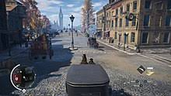

Assassin's Creed Syndicate is an action-adventure video game developed by Ubisoft Quebec and published by Ubisoft. It was released on October 23, 2015, for PlayStation 4 and Xbox One, and on November 19, 2015, for Windows. It is the ninth major installment in the Assassin's Creed series, and the successor to 2014's Assassin's Creed Unity.
PC System requirements
Minimum
OS: Windows : 7/8.1/10(64bit)
Processor: Intel core i7-3770 2.5GHZ or AMD FX-6350 3,9GHZ
Video: GTX 66O /AMD R9 270/(3GB VRAM Shader mode 5.0l).
RAM: 6 GB.
Storage: 50 GB.
Sound Card: DirectX 11c–compliant sound card.
HOME
The game's plot follows the premise of the Assassin's Creed franchise, involving a fictional history of real-world events where a secret war has been fought for centuries between two factions: the Assassins, who promote peace and liberty, and the Templars, who desire peace through control. The framing story is set in the 21st century and features the same unnamed and unseen protagonist from Assassin's Creed Unity, who assists the Assassins in their race against the Templars to find an artifact hidden in London. The main story is set in London in 1868, at the onset of the Second Industrial Revolution, and follows twin Assassins Jacob and Evie Frye as they navigate the corridors of organised crime and take back the city from Templar control. The game also includes segments set in 1916, during World War I, which follow Jacob's granddaughter, Lydia Frye.
Denuwan(WHDR) creation

Slide 36
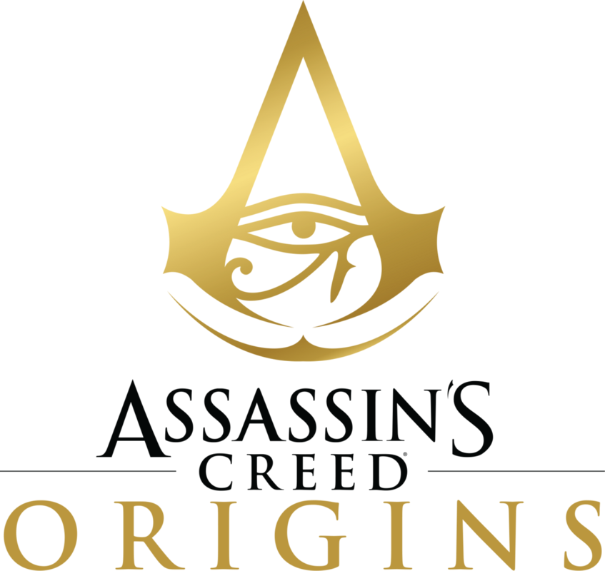


EVOLUTION
HOME
Denuwan(WHDR) creation

Slide 37
EVOLUTION
HOME
Denuwan(WHDR) creation

Slide 38
EVOLUTION
HOME
Denuwan(WHDR) creation

Slide 39
EVOLUTION
HOME
Denuwan(WHDR) creation

Slide 40






EVOLUTION
HOME
Assassin's Creed Origins is a 2017 action role-playing video game developed by Ubisoft Montreal and published by Ubisoft. It is the tenth major install in the Assassin's Creed series, following 2015's Assassin's Creed Syndicate.
PC System requirements
Minimum
OS: Windows : 7/8.1/10(64bit)
Processor: Intel core i5-2400s 2.5GHZ or AMD FX-6350 3,9GHZ
Video: GTX 66O AMD R9 270(2GB VRAM Shader mode 5.0l).
RAM: 6 GB.
Storage: 50 GB.
Sound Card: DirectX 11c–compliant sound card.
Principally set in Egypt, near the end of the Ptolemaic period from 49 to 43 BC, the story follows a Medjay named Bayek of Siwa and his wife Aya as they seek revenge for the murder of their son, and explores the origins of the millennia-long conflict between the Hidden Ones—forerunners to the Assassin Brotherhood, and the Order of the Ancients—forerunners to the Templar Order. The framing story, set in the 21st century, follows a new character, Layla Hassan, who relives Bayek and Aya's memories using a modified Animus device.
Denuwan(WHDR) creation
The open world includes all of Ancient Egypt, featuring vast deserts, oasis, lakes and ancient cities such as Alexandria and Memphis.The game's main character, Bayek, can dive underwater and explore the lakes and the rivers, the first instance of underwater exploration in the series since 2013's Black Flag.These side missions, which typically involve rescuing prisoners, defeating enemies, collecting items or investigating items of interest, often take Bayek to locations of interest, where the player can find treasures.

Slide 41

EVOLUTION
HOME
Assassin's Creed Odyssey is a 2018 action role-playing video game developed by Ubisoft Quebec and published by Ubisoft. It is the eleventh major installment in the Assassin's Creed series and the successor to 2017's Assassin's Creed Origins. Like its predecessor, the game features a large open world and adopts many elements from the role-playing genre, putting more emphasis on combat and exploration than stealth. Naval combat from previous titles in the series also plays a prominent role in Odyssey
PC System requirements
Minimum
OS: Windows : 7sp1/8.1/10(64bit)
Processor: Intel core i5-2400s 3.1GHZ or AMD FX-6350 3,9GHZ
Video: GTX 66O AMD R9 270(2GB VRAM Shader mode 5.0l).
RAM: 8 GB.
Storage: 50 GB.
Sound Card: DirectX 12c–compliant sound card.
Resolution: 720p.
.
Denuwan(WHDR) creation
The game's plot tells a mythological history of the Peloponnesian War between Athens and Sparta from 431 to 422 BC. Players control a Spartan mercenary, who fights on both sides of the conflict as they attempt to find their family and eliminate the mysterious Cult of Kosmos. Odyssey also continues the story arc of Layla Hassan, a major character introduced in Origins, who relives the mercenary's memories through the Animus device to find a powerful artifact.

Slide 42

EVOLUTION
HOME
Assassin's Creed Valhalla is a 2020 action role-playing video game developed by Ubisoft Montreal and published by Ubisoft. It is the twelfth major install in the Assassin's Creed series, and the successor to 2018's Assassin's Creed Odyssey.
PC System requirements
Minimum
OS: Windows : 7/8.1/10(64bit)
Processor: Intel core i5-4460s 3.2GHZ or AMD Ryzen 3
Video: GTX 960 AMD R9 380(2GB VRAM Shader mode 5.0).
RAM: 8 GB.
Storage: 50 GB.
Sound Card: DirectX 12c–compliant sound card.
Principally set in the years 872–878 AD, the game recounts a fictional story during the Viking expansions into the British Isles. Players control Eivor Varinsdottir, a Viking raider who, while attempting to establish a new Viking clan in England, becomes embroiled in the centuries-old conflict between the Assassin Brotherhood, who fight for peace and liberty, and the Templar Order, who desire peace through control. The game also includes a framing story, set in the 21st century, which follows Layla Hassan, an Assassin who relives Eivor's memories so as to find a way to save the Earth from destruction.
Denuwan(WHDR) creation

Slide 43



Assassin's Creed Odyssey is a 2018 action role-playing video game developed by Ubisoft Quebec and published by Ubisoft. It is the eleventh major installment in the Assassin's Creed series and the successor to 2017's Assassin's Creed Origins. Like its predecessor, the game features a large open world and adopts many elements from the role-playing genre, putting more emphasis on combat and exploration than stealth. Naval combat from previous titles in the series also plays a prominent role in Odyssey
PC System requirements
Minimum
OS: Windows : 7sp1/8.1/10(64bit)
Processor: Intel core i5-2400s 3.1GHZ or AMD FX-6350 3,9GHZ
Video: GTX 66O AMD R9 270(2GB VRAM Shader mode 5.0l).
RAM: 8 GB.
Storage: 50 GB.
Sound Card: DirectX 11c–compliant sound card.
Resolution: 720p.
.
HOME
The game's plot tells a mythological history of the Peloponnesian War between Athens and Sparta from 431 to 422 BC. Players control a Spartan mercenary, who fights on both sides of the conflict as they attempt to find their family and eliminate the mysterious Cult of Kosmos. Odyssey also continues the story arc of Layla Hassan, a major character introduced in Origins, who relives the mercenary's memories through the Animus device to find a powerful artifact.
Denuwan(WHDR) creation

Slide 44
Assassin's Creed Origins is a 2017 action role-playing video game developed by Ubisoft Montreal and published by Ubisoft. It is the tenth major install in the Assassin's Creed series, following 2015's Assassin's Creed Syndicate.
PC System requirements
Minimum
OS: Windows : 7/8.1/10(64bit)
Processor: Intel core i5-2400s 2.5GHZ or AMD FX-6350 3,9GHZ
Video: GTX 66O AMD R9 270(2GB VRAM Shader mode 5.0l).
RAM: 6 GB.
Storage: 50 GB.
Sound Card: DirectX 11c–compliant sound card.
Principally set in Egypt, near the end of the Ptolemaic period from 49 to 43 BC, the story follows a Medjay named Bayek of Siwa and his wife Aya as they seek revenge for the murder of their son, and explores the origins of the millennia-long conflict between the Hidden Ones—forerunners to the Assassin Brotherhood, and the Order of the Ancients—forerunners to the Templar Order. The framing story, set in the 21st century, follows a new character, Layla Hassan, who relives Bayek and Aya's memories using a modified Animus device.
HOME
The open world includes all of Ancient Egypt, featuring vast deserts, oasis, lakes and ancient cities such as Alexandria and Memphis.The game's main character, Bayek, can dive underwater and explore the lakes and the rivers, the first instance of underwater exploration in the series since 2013's Black Flag.These side missions, which typically involve rescuing prisoners, defeating enemies, collecting items or investigating items of interest, often take Bayek to locations of interest, where the player can find treasures.
Denuwan(WHDR) creation

Slide 45



Principally set in the years 872–878 AD, the game recounts a fictional story during the Viking expansions into the British Isles. Players control Eivor Varinsdottir, a Viking raider who, while attempting to establish a new Viking clan in England, becomes embroiled in the centuries-old conflict between the Assassin Brotherhood, who fight for peace and liberty, and the Templar Order, who desire peace through control. The game also includes a framing story, set in the 21st century, which follows Layla Hassan, an Assassin who relives Eivor's memories so as to find a way to save the Earth from destruction.
HOME
Denuwan(WHDR) creation

Slide 46




HOME
Who are the assassins
The Assassin Brotherhood, also known as the Assassin Order and originally as the Hidden Ones, is a secret global peacekeeping organization dedicated to protecting humanity from abuses of power, coercive rule, and injustice. As the etymology of the term assassin, their traditional methods have revolved around stealth operations, selective violence, and the assassination of those deemed to be perpetrators of oppression under the belief that this minimizes collateral damage in accordance with their absolute prohibition against harming innocent lives.
Who are the Templar
The Templar knights, in their distinctive white mantles with a red cross, were among the most skilled fighting units of the Crusades. They were prominent in Christian finance; non-combatant members of the order, who made up as much as 90% of their members, managed a large economic infrastructure throughout Christendom.
Denuwan(WHDR) creation
ANIMUS
The Animus is a virtual reality machine that allows users to communicate and interact with ancestral memories via their genetic code
In the 1930s, the Templars started their experiments using knowledge attained from one of the Pieces of Eden called the Apple of Eden. The Templars hoped that they could create a machine that would enable users to interact with the memories of their ancestors. Not just fathers and grandfathers, but ancestors twelve generations back and more- by analyzing a portion of the user’s DNA, the machine would reconstruct their ancestors’ life through a virtual simulation.

Slide 47
Who are the assassins
The Assassin Brotherhood, also known as the Assassin Order and originally as the Hidden Ones, is a secret global peacekeeping organization dedicated to protecting humanity from abuses of power, coercive rule, and injustice. As the etymology of the term assassin, their traditional methods have revolved around stealth operations, selective violence, and the assassination of those deemed to be perpetrators of oppression under the belief that this minimizes collateral damage in accordance with their absolute prohibition against harming innocent lives.
Who are the Templar
The Templar knights, in their distinctive white mantles with a red cross, were among the most skilled fighting units of the Crusades. They were prominent in Christian finance; non-combatant members of the order, who made up as much as 90% of their members, managed a large economic infrastructure throughout Christendom.
ANIMUS
HOME
The Animus is a virtual reality machine that allows users to communicate and interact with ancestral memories via their genetic code
In the 1930s, the Templars started their experiments using knowledge attained from one of the Pieces of Eden called the Apple of Eden. The Templars hoped that they could create a machine that would enable users to interact with the memories of their ancestors. Not just fathers and grandfathers, but ancestors twelve generations back and more- by analyzing a portion of the user’s DNA, the machine would reconstruct their ancestors’ life through a virtual simulation.
Denuwan(WHDR) creation
Game | Historical character Period/Era | Present-day character
Assassin’s Creed | Altaïr Ibn-LaʼAha Third Crusade | Desmond Miles
Assassin's Creed II | Ezio Auditore da Firenz Italian Renaissance
Assassin's Creed: Brotherhood
Assassin's Creed: Revelations | Ezio Auditore da Firenze Ottoman Civil War Altaïr Ibn-LaʼAha Third Crusade & Mongol invasion of the Levant
Assassin's Creed III | Haytham Kenway French and Indian War Ratonhnhaké ton / Connor American Revolution
Assassin's Creed IV: Black Flag | Edward Kenway Golden Age of Piracy | Noob" / Abstergo researcher
Assassin's Creed Rogue | Shay Patrick Cormac French and Indian War | Numbskull" / Helix researcher
Assassin's Creed Unity | Arno Dorian French Revolution | The Initiate" / Helix player
Assassin's Creed Syndicate | Jacob and Evie Frye Victorian England Lydia Frye World War I
Assassin's Creed Origins | Bayek and Aya Ptolemaic Egypt | Layla Hassan
Assassin's Creed Odyssey | Alexios / Kassandra Peloponnesian War
Assassin's Creed Valhalla | Eivor Varinsdottir Viking invasion of England Odin / Havi Isu Era | Layla Hassan Basim Ibn Isha

Slide 48
ANIMUS
The Animus is a virtual reality machine that allows users to communicate and interact with ancestral memories via their genetic code
In the 1930s, the Templars started their experiments using knowledge attained from one of the Pieces of Eden called the Apple of Eden. The Templars hoped that they could create a machine that would enable users to interact with the memories of their ancestors. Not just fathers and grandfathers, but ancestors twelve generations back and more- by analyzing a portion of the user’s DNA, the machine would reconstruct their ancestors’ life through a virtual simulation.
HOME
Game | Historical character Period/Era | Present-day character
Assassin’s Creed | Altaïr Ibn-LaʼAha Third Crusade | Desmond Miles
Assassin's Creed II | Ezio Auditore da Firenz Italian Renaissance
Assassin's Creed: Brotherhood
Assassin's Creed: Revelations | Ezio Auditore da Firenze Ottoman Civil War Altaïr Ibn-LaʼAha Third Crusade & Mongol invasion of the Levant
Assassin's Creed III | Haytham Kenway French and Indian War Ratonhnhaké ton / Connor American Revolution
Assassin's Creed IV: Black Flag | Edward Kenway Golden Age of Piracy | Noob" / Abstergo researcher
Assassin's Creed Rogue | Shay Patrick Cormac French and Indian War | Numbskull" / Helix researcher
Assassin's Creed Unity | Arno Dorian French Revolution | The Initiate" / Helix player
Assassin's Creed Syndicate | Jacob and Evie Frye Victorian England Lydia Frye World War I
Assassin's Creed Origins | Bayek and Aya Ptolemaic Egypt | Layla Hassan
Assassin's Creed Odyssey | Alexios / Kassandra Peloponnesian War
Assassin's Creed Valhalla | Eivor Varinsdottir Viking invasion of England Odin / Havi Isu Era | Layla Hassan Basim Ibn Isha
Denuwan(WHDR) creation

Slide 49
Game | Historical character Period/Era | Present-day character
Assassin’s Creed | Altaïr Ibn-LaʼAha Third Crusade | Desmond Miles
Assassin's Creed II | Ezio Auditore da Firenz Italian Renaissance
Assassin's Creed: Brotherhood
Assassin's Creed: Revelations | Ezio Auditore da Firenze Ottoman Civil War Altaïr Ibn-LaʼAha Third Crusade & Mongol invasion of the Levant
Assassin's Creed III | Haytham Kenway French and Indian War Ratonhnhaké ton / Connor American Revolution
Assassin's Creed IV: Black Flag | Edward Kenway Golden Age of Piracy | Noob" / Abstergo researcher
Assassin's Creed Rogue | Shay Patrick Cormac French and Indian War | Numbskull" / Helix researcher
Assassin's Creed Unity | Arno Dorian French Revolution | The Initiate" / Helix player
Assassin's Creed Syndicate | Jacob and Evie Frye Victorian England Lydia Frye World War I
Assassin's Creed Origins | Bayek and Aya Ptolemaic Egypt | Layla Hassan
Assassin's Creed Odyssey | Alexios / Kassandra Peloponnesian War
Assassin's Creed Valhalla | Eivor Varinsdottir Viking invasion of England Odin / Havi Isu Era | Layla Hassan Basim Ibn Isha
HOME
Denuwan(WHDR) creation

